Slide 1
Inorganic Chemistry
CHE 2205
(2 credits)
(30 hours)

Slide 2
Course aims
The aim is provide an overview of both modern and classical treatments of bonding in coordination compounds, and to apply the various structural models to the detailed interpretation of spectral and magnetic properties.

Slide 3
Course ILOs:
On successful completion of the course students should be able to
construct molecular orbitals for mononuclear metal complexes, and to derive quantitative orbital energy schemes.
use molecular orbital methods to interpret the position of ligands in the spectrochemical series.
derive the energy levels of free metal ions, and how these are influenced by the ligands.

Slide 4
use correlation diagrams to describe how energy levels change in metal complexes as the ligand-field strength changes.
apply appropriate bonding models to the interpretation of electronic spectra and to extract chemically useful information from these spectra.
describe the catalytic properties of transition metals and industrial applications of their compounds.
specify atomic planes, directions and families of planes and directions within a given crystal structure using Miller indices.
predict decay and reactions
explain the courses of radio activity and radio decay.
describe the process of decay and predict the products.

Slide 5
Course capsule:
Coordination Chemistry (15 h)
IUPAC nomenclature of transition metal complexes, Types of ligands, Coordination chemistry of metal complexes, Isomers, Hybridization and geometry. Bonding theories of transition metal complexes, crystal field theory, ligand field theory and molecular orbital theory. Jahn Teller theory and its applications. Variation in colour, Magnetic properties and reactivity of coordination complexes.

Slide 6
Solid state (10 h)
Classification of Solids: Crystalline solids, amorphous solids, distinction between crystalline and amorphous solids, molecular crystals (van der Waals crystal), covalent crystals, ionic crystals.
The crystal Structures of Ionic Materials: Pauling groups, Crystal types: simple cubic (c), body centered cubic (bcc), face centered cubic (fcc/ccp) hexagonal close packed (hcp) etc., tetrahedral and octahedral holes, coordination number, unit cell, crystal systems, Miller indices and their significance.

Slide 7
Nuclear and radio chemistry (5 h)
Atomic nucleus, radio isotopes, binding energy, nuclear stability, radioactivity and decay, nuclear reactions, effects of radiation on matter.

Slide 8
Teaching methods:
Lectures
Assignments and
Turorials/quizzes

Slide 9
Course evaluation
Assessment | Contribution to Course Grade (%)
Continuous assessment | 10
Mid semester examination | 20
End semester Examination theory | 70

Slide 10
Recommended Texts:
1. J.D.Lee (2006) Concise Inorganic Chemistry, 5th Edition, Blackwell Science, London
2. D F Shriver and P W Atkins (2006) Inorganic Chemistry, 4th Edition, W H Freeman and Co. London
3. J E Hutheey, E A Keiter and R L Keither (1997) Inorganic Chemistry, 4th Edition, Harper Collins, New York
4. T Moeller (1990) Inorganic Chemistry: A Moderen Introduction, New York.

Slide 11
IUPAC nomenclature of transition metal complexes

Slide 12
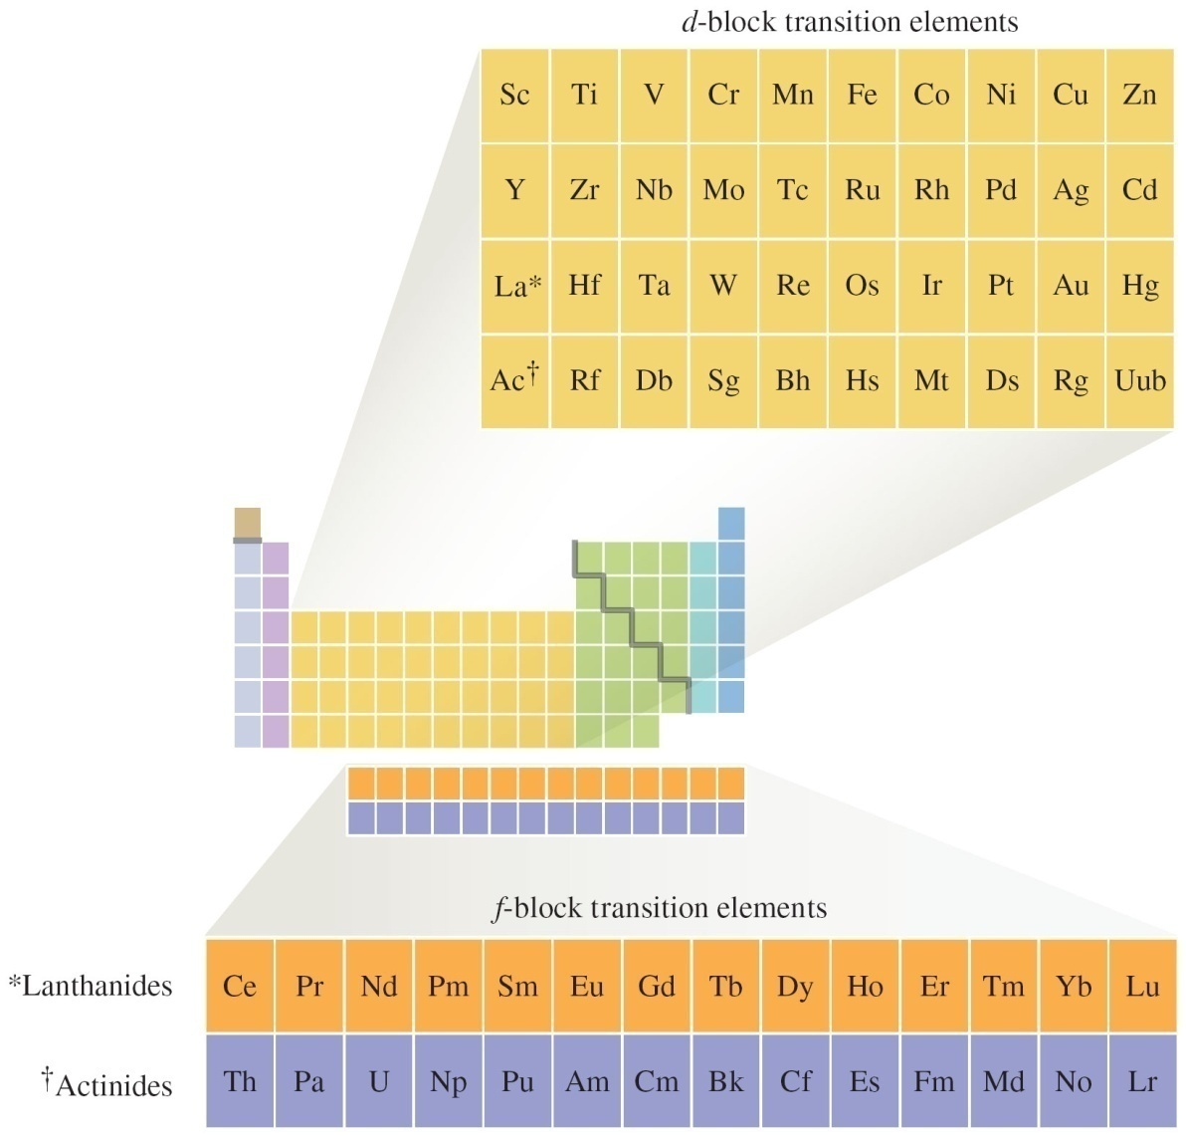
The Position of the Transition Elements on the Periodic Table

Slide 13
Forming Ionic Compounds
Transition metals generally exhibit more than one oxidation state.
Cations are often complex ions – species where the transition metal ion is surrounded by a certain number of ligands (Lewis bases).

Slide 14
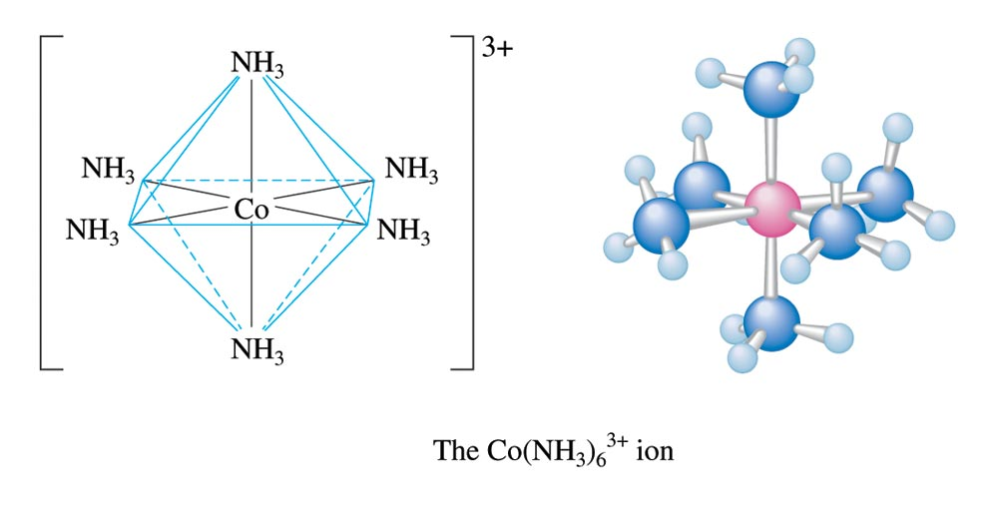
The Complex Ion Co(NH₃)₆³⁺

Slide 15
Ionic Compounds with Transition Metals
Most compounds are colored because the transition metal ion in the complex ion can absorb visible light of specific wavelengths.
Many compounds are paramagnetic.

Slide 16
Ionic Compounds with Transition Metals
Most compounds are colored because the transition metal ion in the complex ion can absorb visible light of specific wavelengths.
Many compounds are paramagnetic.

Slide 17
Electron Configurations
Example
V: [Ar]4s²3d³
Fe: [Ar]4s²3d⁶
Exceptions: Cr and Cu
Cr: [Ar]4s¹3d⁵
Cu: [Ar]4s¹3d¹⁰

Slide 18
Electron Configurations
First-row transition metal ions do not have 4s electrons.
Energy of the 3d orbitals is less than that of the 4s orbital.
Ti: [Ar]4s²3d²
Ti³⁺: [Ar]3d¹

Slide 19
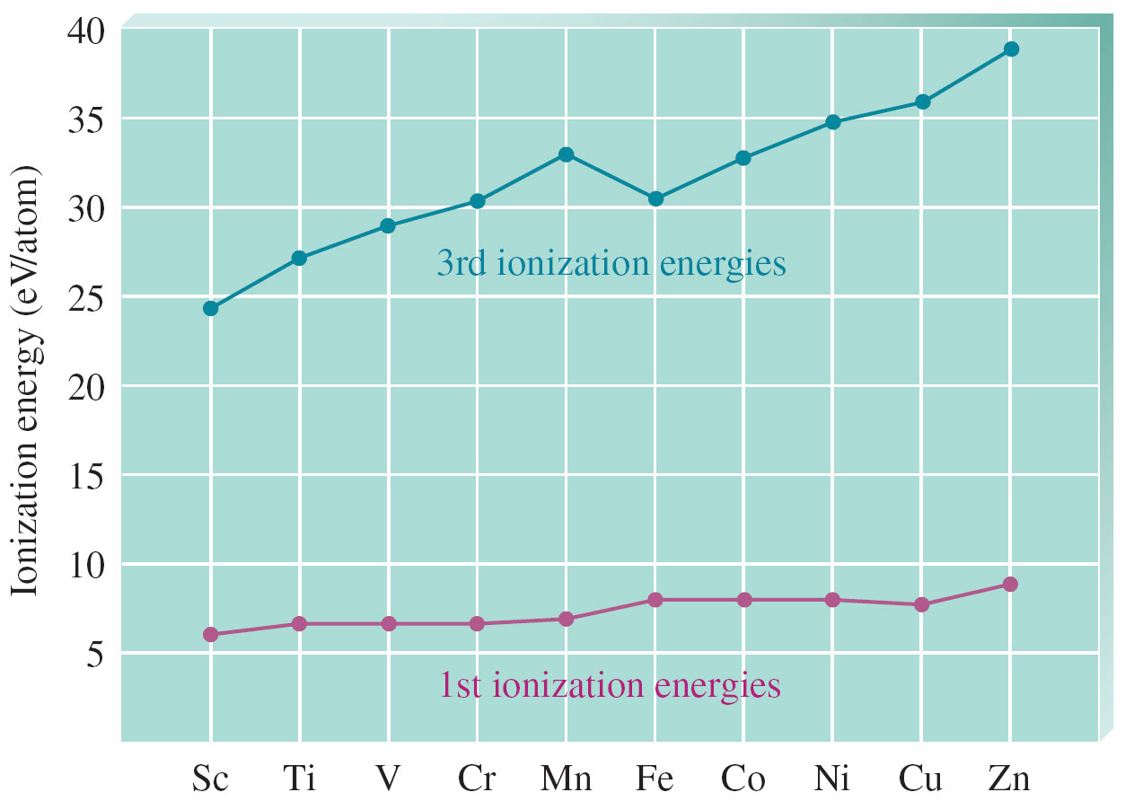
Plots of the First (Red Dots) and Third (Blue Dots) Ionization Energies for the First-Row Transition Metals

Slide 20
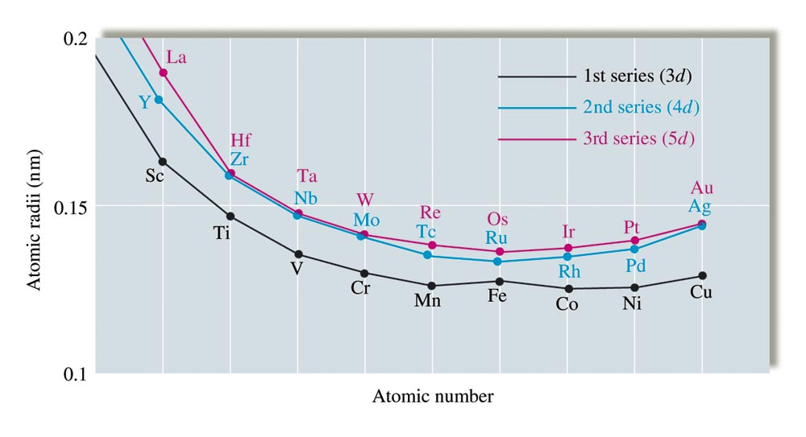
Atomic Radii of the 3d, 4d, and 5d Transition Series

Slide 21
3d Transition Metals
Scandium – chemistry strongly resembles lanthanides
Titanium – excellent structural material (light weight)
Vanadium – mostly in alloys with other metals
Chromium – important industrial material
Manganese – production of hard steel
Iron – most abundant heavy metal
Cobalt – alloys with other metals
Nickel – plating more active metals; alloys
Copper – plumbing and electrical applications
Zinc – galvanizing steel

Slide 22
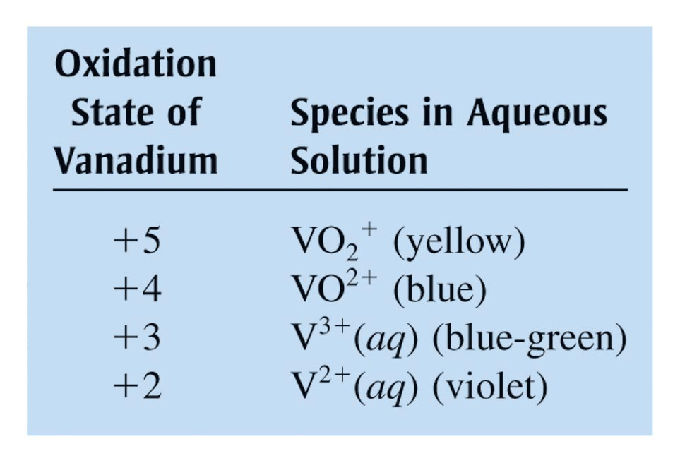
Oxidation States and Species for Vanadium in Aqueous Solution

Slide 23
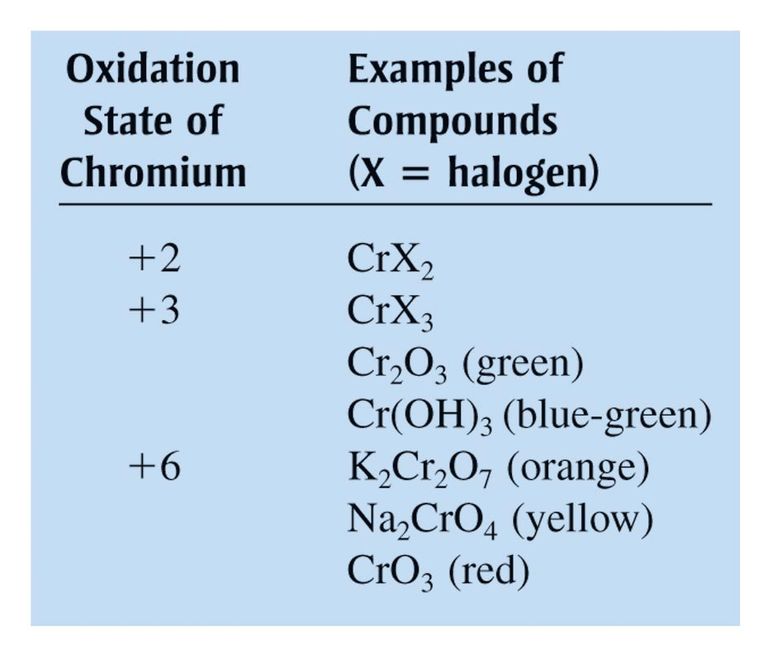
Typical Chromium Compounds

Slide 24
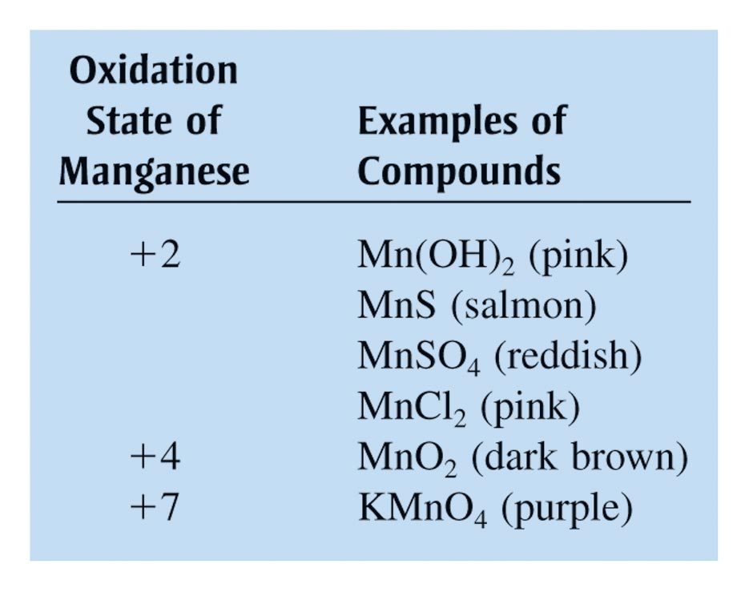
Some Compounds of Manganese in Its Most Common Oxidation States

Slide 25
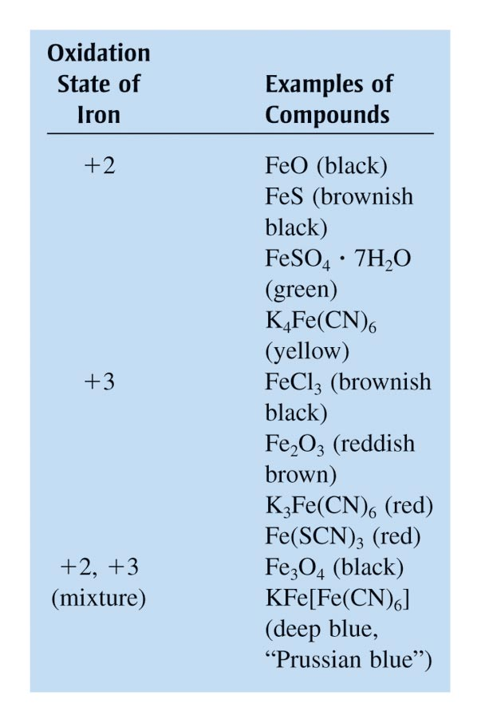
Typical Compounds of Iron

Slide 26
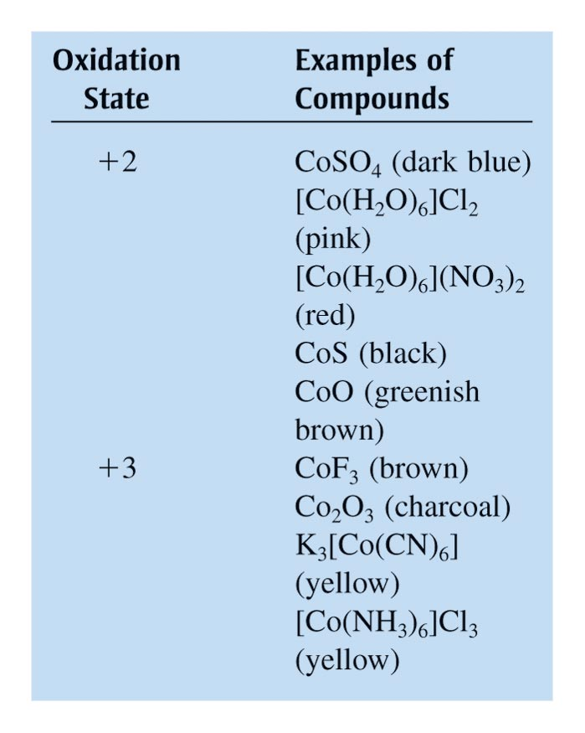
Typical Compounds of Cobalt

Slide 27
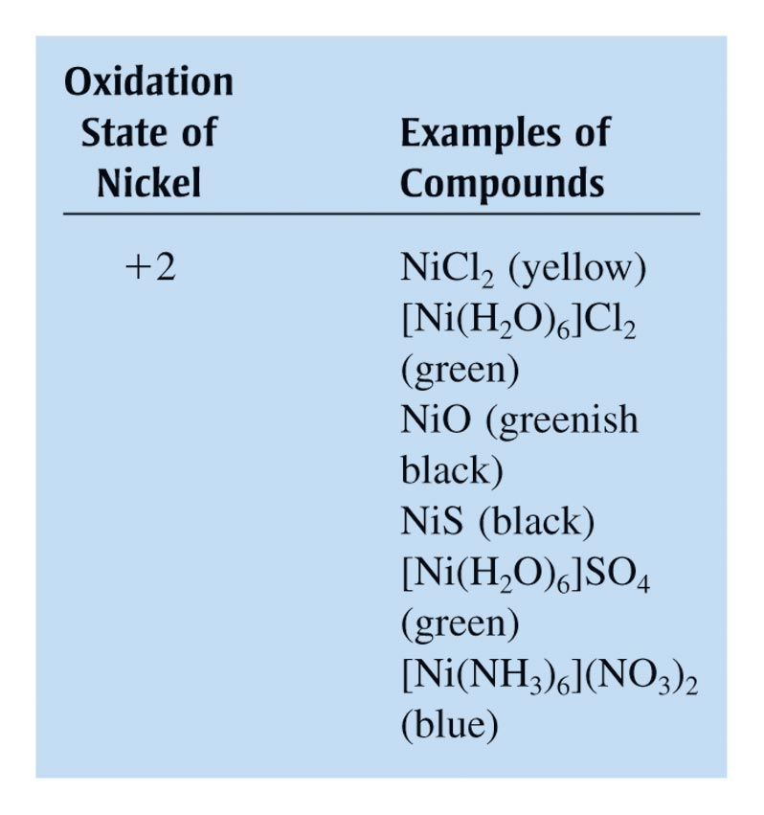
Typical Compounds of Nickel

Slide 28
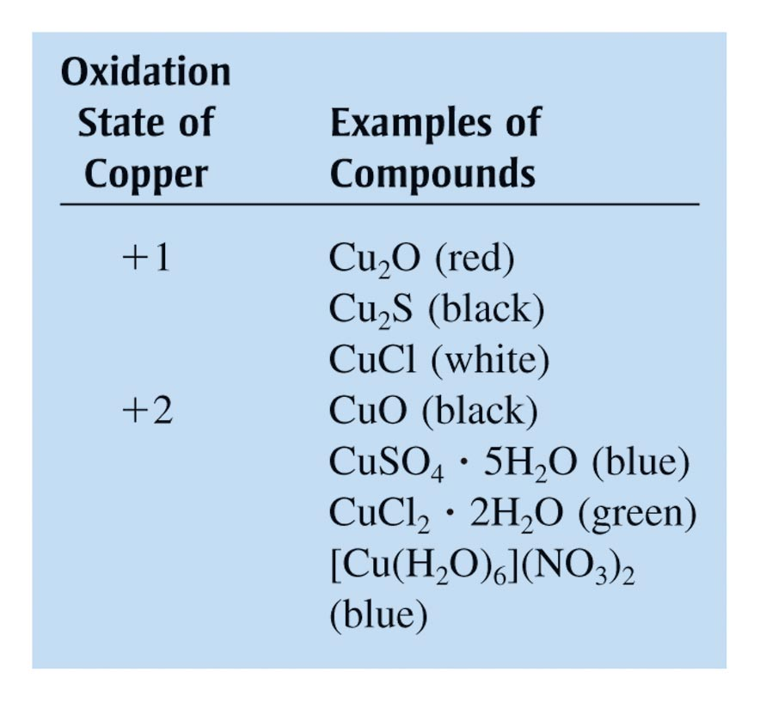
Typical Compounds of Copper

Slide 29
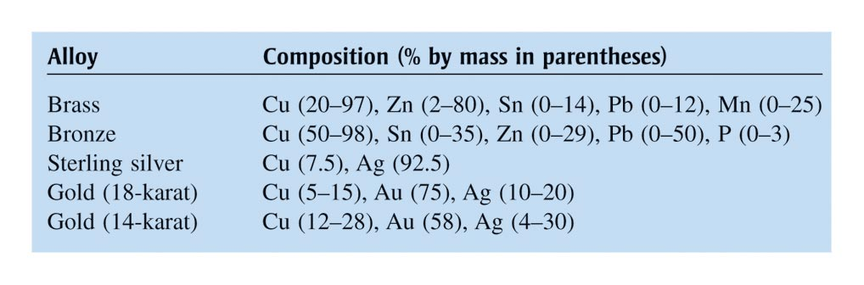
Alloys Containing Copper

Slide 30
A Coordination Compound
Typically consists of a complex ion and counterions (anions or cations as needed to produce a neutral compound):
[Co(NH₃)₅Cl]Cl₂
[Fe(en)₂(NO₂)₂]₂SO₄
K₃Fe(CN)₆

Slide 31
Coordination Number
Number of bonds formed between the metal ion and the ligands in the complex ion.
6 and 4 (most common)
2 and 8 (least common)

Slide 32
Ligands
Neutral molecule or ion having a lone electron pair that can be used to form a bond to a metal ion.
Monodentate ligand – one bond to a metal ion
Bidentate ligand (chelate) – two bonds to a metal ion
Polydentate ligand – more than two bonds to a metal ion

Slide 33
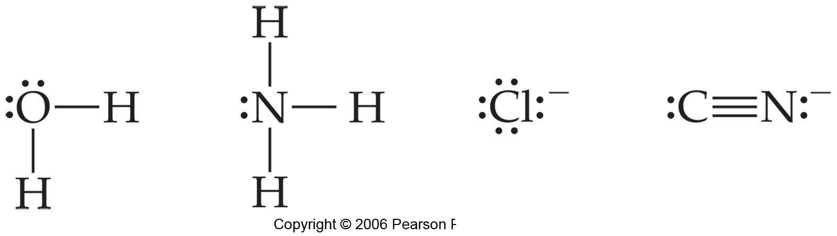
Complexes
The molecules or ions coordinating to the metal are the ligands.
They are usually anions or polar molecules.
The must have lone pairs to interact with metal

Slide 34
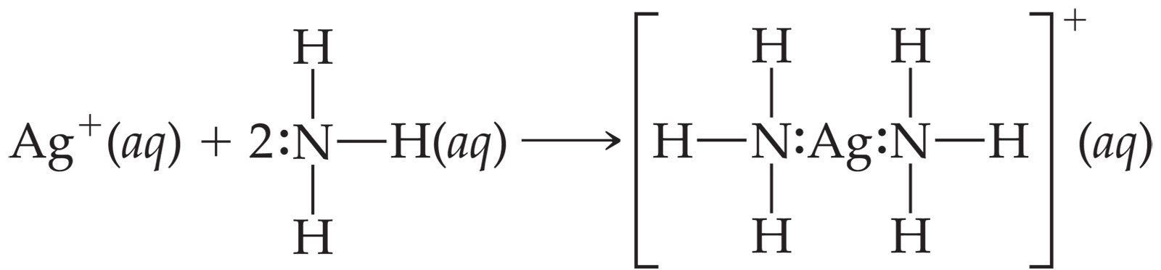
Metal-Ligand Bond
This bond is formed between a Lewis acid and a Lewis base.
The ligands (Lewis bases) have nonbonding electrons.
The metal (Lewis acid) has empty orbitals.

Slide 35
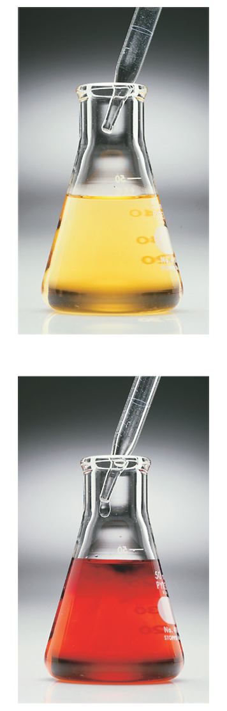
Metal-Ligand Bond
The metal’s coordination ligands and geometry can greatly alter its properties, such as colour, or ease of oxidation.

Slide 36
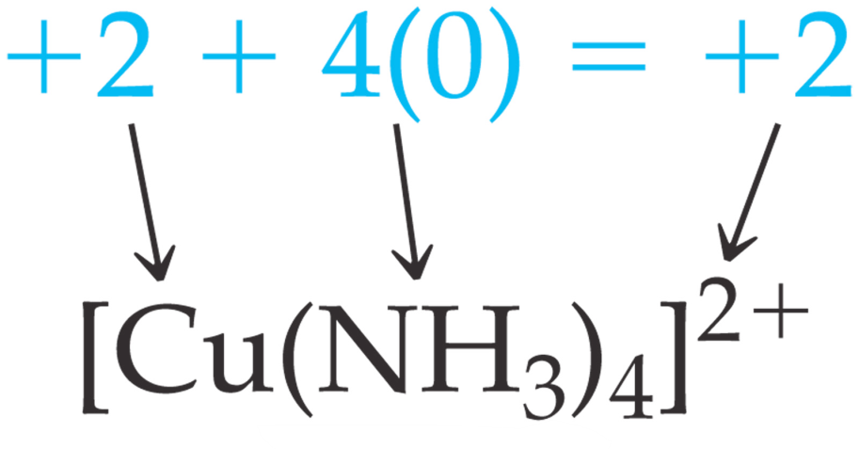
Oxidation Numbers
Knowing the charge on a complex ion and the charge on each ligand, one can determine the oxidation number for the metal.

Slide 37
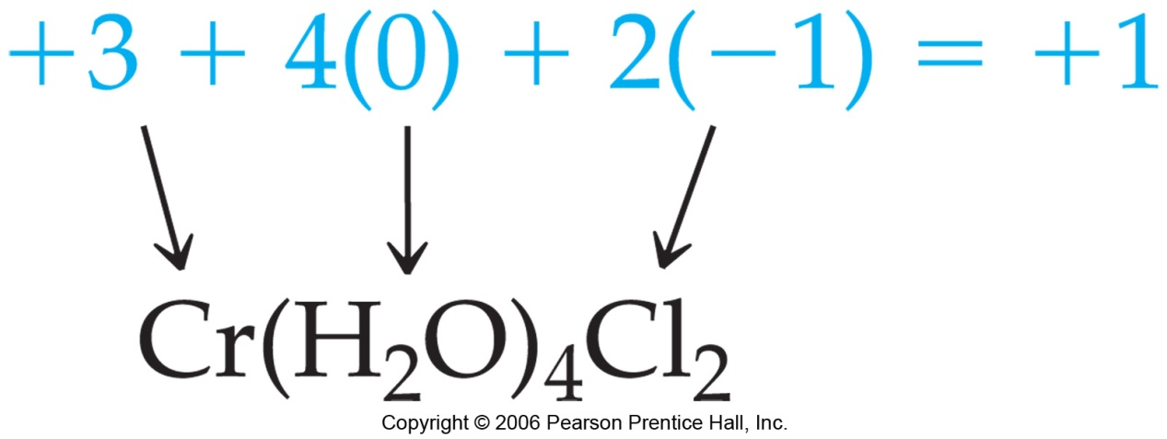
Oxidation Numbers
Or, knowing the oxidation number on the metal and the charges on the ligands, one can calculate the charge on the complex ion.
Example: Cr(III)(H₂O)₄Cl₂

Slide 38
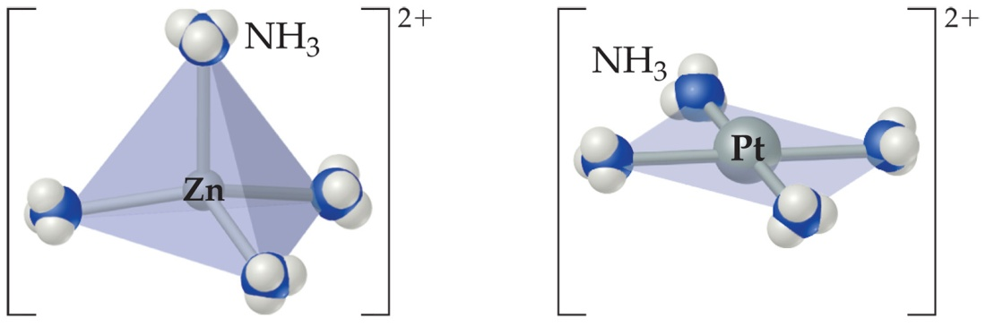
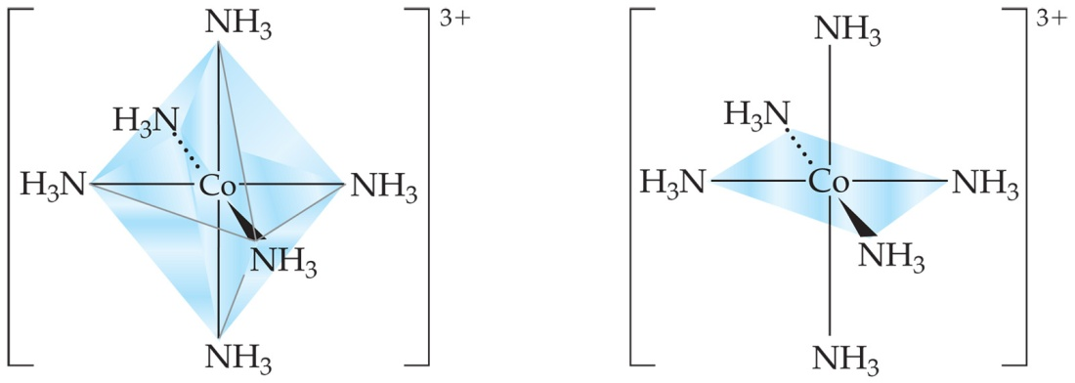
Coordination Number
The atom that supplies the lone pairs of electrons for the metal-ligand bond is the donor atom.
The number of these atoms is the coordination number.

Slide 39


Coordination Number
Some metals, such as chromium(III) and cobalt(III), consistently have the same coordination number (6 in the case of these two metals).
The most commonly encountered numbers are 4 and 6.

Slide 40
Coordinate Covalent Bond
Bond resulting from the interaction between a Lewis base (the ligand) and a Lewis acid (the metal ion).

Slide 41
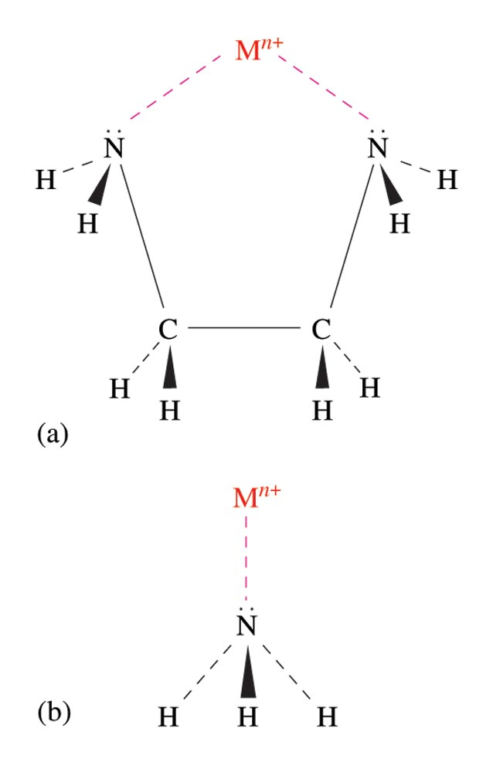
The Bidentate Ligand Ethylenediamine and the Monodentate Ligand Ammonia

Slide 42
Coordination Chemistry
Ligands
classified according to the number of donor atoms
Examples
monodentate = 1
bidentate = 2
tetradentate = 4
hexadentate = 6
polydentate = 2 or more donor atoms
chelating agents

Slide 43
Ligands
Monodentate
Examples:
H₂O, CN⁻, NH₃, NO₂⁻, SCN⁻, OH⁻, X⁻ (halides), CO, O²⁻
Example Complexes
[Co(NH₃)₆]³⁺
[Fe(SCN)₆]³⁻

Slide 44
Ligands
Bidentate
Examples
oxalate ion = C₂O₄²⁻
ethylenediamine (en) = NH₂CH₂CH₂NH₂
ortho-phenanthroline (o-phen)
Example Complexes
[Co(en)₃]³⁺
[Cr(C₂O₄)₃]³⁻
[Fe(NH₃)₄(o-phen)]³⁺

Slide 45
Ligands
oxalate ion
ethylenediamine
*
*
*
*
ortho-phenanthroline
*
*
Donor Atoms

Slide 46
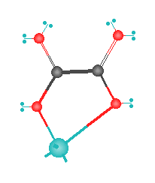
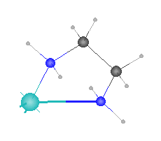
Ligands
oxalate ion
ethylenediamine
H
C
C
O
M
N
M

Slide 47
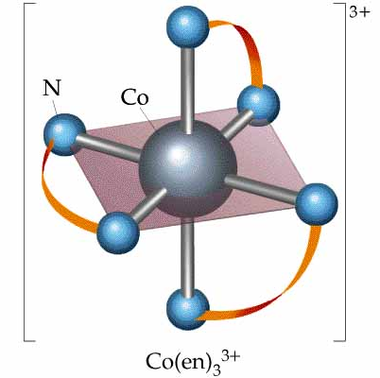
Ligands

Slide 48
Ligands
Hexadentate
ethylenediaminetetraacetate (EDTA) = (O₂CCH₂)₂N(CH₂)₂N(CH₂CO₂)₂⁴⁻
Example Complexes
[Fe(EDTA)]⁻¹
[Co(EDTA)]⁻¹

Slide 49
Ligands
EDTA
*
*
*
*
*
*
Donor Atoms

Slide 50
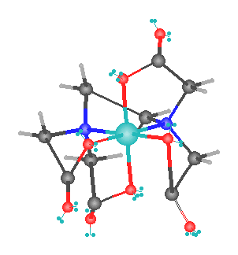
Ligands
EDTA
O
H
C
N
M

Slide 51
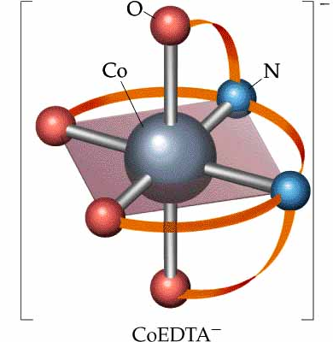
Ligands
EDTA

Slide 52
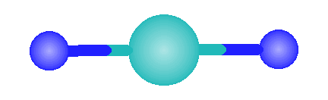
Common Geometries of Complexes
Coordination Number Geometry
2
Linear
Example: [Ag(NH₃)₂]⁺

Slide 53
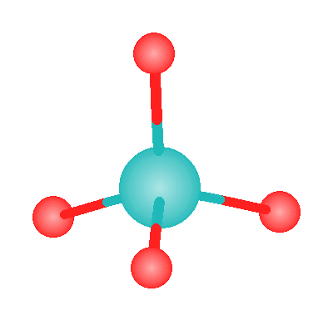
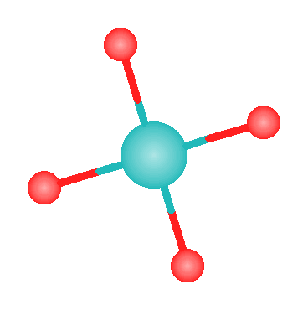
Common Geometries of Complexes
Coordination Number Geometry
4
tetrahedral
Examples: [Zn(NH₃)₄]²⁺, [FeCl₄]⁻
square planar
Example: [Ni(CN)₄]²⁻

Slide 54
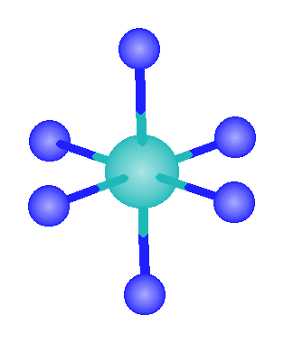
Common Geometries of Complexes
Coordination Number Geometry
6
Examples: [Co(CN)₆]³⁻, [Fe(en)₃]³⁺
octahedral

Slide 55
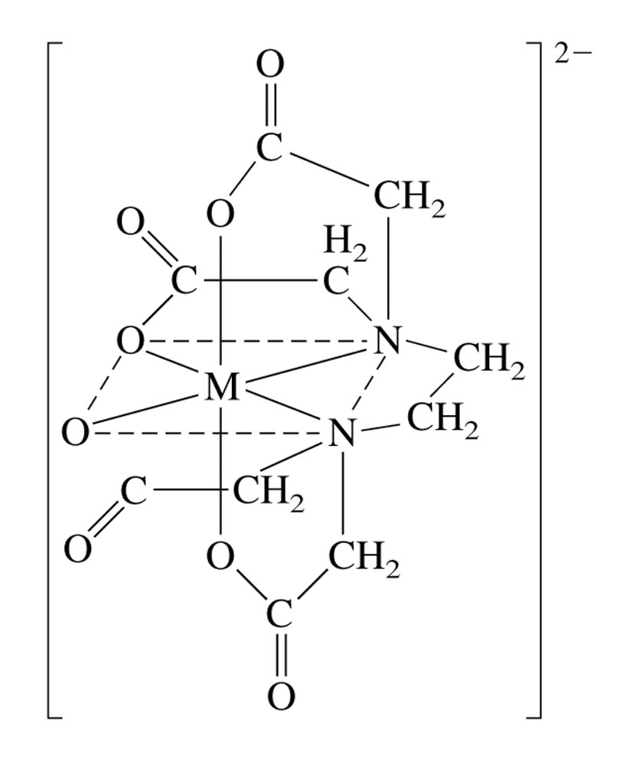
The Coordination of EDTA with a 2+ Metal Ion
ethylenediaminetetraacetate

Slide 56
Rules for Naming Coordination Compounds
[Co(NH₃)₅Cl]Cl₂
Cation is named before the anion.
“chloride” goes last (the counterion)
Ligands are named before the metal ion.
ammonia (ammine) and chlorine
(chlorido) named before cobalt

Slide 57
Rules for Naming Coordination Compounds
[Co(NH₃)₅Cl]Cl₂
For negatively charged ligands, an “o” is added to the root name of an anion (such as fluoro, bromo, chloro, etc.).
The prefixes mono-, di-, tri-, etc., are used to denote the number of simple ligands.
penta ammine

Slide 58
Rules for Naming Coordination Compounds
[Co(NH₃)₅Cl]Cl₂
The oxidation state of the central metal ion is designated by a Roman numeral:
cobalt (III)
When more than one type of ligand is present, they are named alphabetically:
pentaamminechlorido

Slide 59
Rules for Naming Coordination Compounds
[Co(NH₃)₅Cl]Cl₂
If the complex ion has a negative charge, the suffix “ate” is added to the name of the metal.
The correct name is:
pentaamminechloridocobalt(III) chloride

Slide 60
Naming coordination compounds (new)
The following rules are used when naming coordination compounds:
(i) ligand names are listed before the name of the central atom,
(ii) no spaces are left between parts of the name that refer to the same coordination entity,

Slide 61
(iii) ligand names are listed in alphabetical order
Note: (numerical prefixes indicating the number of ligands are not considered in determining that order),
(iv) the use of abbreviations in names is discouraged.

Slide 62
Example:
1. [CoCl(NH₃)₅]Cl₂
pentaamminechloridocobalt(ll) chloride
pentaamminechloridocobalt(2+) chloride
2. [AuXe₄]²⁺
tetraxenonidogold(ll)
(i) Prefixes di, tri, etc. are generally used for simple ligands. Enclosing marks are not required.
(ii) Prefixes bis, tris, tetrakis, etc. are used with complex expressions and when required to avoid ambiguity.
For example, one would use diammine, for (NH₃)₂, but bis(methylamine), for (NH₂Me)₂, to make a distinction from dimethylamine.

Slide 63
Systematic and alternative names for some common ligands:
(i) Names of anionic ligands, whether inorganic or organic, are modified to end in 'o‘
In general, if the anion name ends in 'ide', 'ite' or 'ate', the final 'e' is replaced by 'o', giving 'ido', 'ito', and 'ato', respectively.
In particular, alcoholates, thiolates, phenolates, carboxylates, partially dehydronated amines, phosphanes, etc.
In its complexes, hydrogen is always treated as anionic. 'Hydrido' is used for hydrogen coordinating to all elements including boron.

Slide 64
(ii) Names of neutral and cationic ligand names, including organic ligands, are used without modification (even if they carry the endings 'ide', 'ite' or 'ate').
(iii) Enclosing marks are required for neutral and cationic ligand names, for inorganic anionic ligands containing numerical prefixes (such as triphosphato), for any compositional name (such as carbon disulfide), for any substituted organic ligand.
However, common ligands such as aqua, ammine, carbonyl, nitrosyl, methyl, ethyl, etc., do not require enclosing marks, unless there is ambiguity.

Slide 65
Examples:
Formula Ligand name
1. Cl_ chlorido
2. CN_ cyanido
3. H_ hydrido
4. D_ or H_ deuterido or [2H]hydrido
5. PhCH₂CH₂Se_ phenylethaneselanolato
6. MeCOO_ acetato or ethanoato
7. Me₂N dimethylazanido or dimethylamido
8. MeCONH₂ acetamide (not acetamido)
9. MeCONH_ acetylazanido or acetylamido (not acetamido)
10. MeNH₂ methanamine
11. MeNH methylazanido or methanaminido
12. MePH₂ methylphosphane
13. MePH_ methylphosphanido
14. MeOS(O)OH methyl hydrogen sulfite
15. MeOS(O)O_ methyl sulfito, or methoxidodioxidosulfato(1-)

Slide 66
Nomenclature of Coordination Complexes
Rule 1: The names of neutral coordination complexes are given without spaces.
For coordination compounds that are ionic (i.e., the coordination complex is either an anion or anion of an ionic substance), the cation is named first and separated by a space from the anion, as is the case for all ionic compounds.
Na [PtCl₃(NH₃)]
Sodium amminetrichloridoplatinate
K₂[CuBr₄]
Potassium tetrabromidocuprate(II)
In the above examples,
the cations sodium and potassium are named first and then separated by a space from the names of the anions.

Slide 67
trans-[Co(en)₂I(H₂O)](NO₃)₂
trans-Aquabis(ethylenediamine)iodidocobalt(III) nitrate In this example the coordination cation is written without spaces and then separated from the name of the anion.
[Ru(PPh₃)₃Cl₃]
Trichloridotris(triphenylphosphine)ruthenium(III)
Here the coordination complex is neutral, so no spaces are necessary.

Slide 68
Rule 2:
The name of the coordination compound (neutral, cationic or anionic) begins with the names of the ligands.
The metal is listed next, following in parentheses by the oxidation state of the metal.

Slide 69
Rule 3:
When more than one of a given ligand is bound to the same metal atom or ion, the number of such ligands is designated by the following prefixes: 2 di 6 hexa 10 deca 3 tri 7 hepta 11 undeca 4 tetra 8 octa 12 dodeca 5 penta 9 nona
However, when the name of the ligand in question already contains one of these prefixes then a prefix from the following list is used instead: 2 bis 3 tris 4 tetrakis 5 pentakis 6 hexakis 7 heptakis 8 octakis 9 ennea

Slide 70
Rule 4:
Neutral ligands are given the same name as the uncoordinated molecule, but with spaces omitted.
Some examples are:
(CH₃)₃SO dimethylsulfoxide (DMSO)
(NH₂)₂CO urea
C₅H₅N pyridine
terpy terpyridine bpy 2,2’- bipyridine en ethylenediamine
PCl₃ trichlorophosphine PPh₃ triphenylphopshine

Slide 71
EXCEPTIONS:
Some neutral molecules, when serving as ligands are given special names.
These are: NH₃ ammine
H₂O aqua
NO nitrosyl
CO carbonyl
CS thiocarbonyl

Slide 72
Rule 5:
Anionic ligands are given names that end in the letter “ido”.
When the name of the free, uncoordinated anion ends in “ate”, the ligand name is changed to end in “ato”.
Some examples are :
CH₃CO²⁻ (acetate) acetato
SO₄²⁻ (sulfate) sulfato
CO₃²⁻ (carbonate) carbonato
acac acetylacetonato When the name of the free, uncoordinated anion ends in “ide”, the ligand name is changed to end in “ido”.
Some examples are: N³⁻ (nitride) nitrido
N₃⁻ (azide) azido
NH₂⁻ (amide) amido
(CH₃)₂N⁻ (dimethylamide) dimethylamido

Slide 73
When the name of the free, uncoordinated anion ends in “ite”, the ligand name is changed to end in “ito”.
Some examples are: NO₂⁻ (nitrite) nitrito
SO₃²⁻ (sulfite) sulfito
ClO₂⁻ (chlorite) chlorito
Certain anionic ligands are given special names, all ending in “ido”: CN- cyanido F- fluorido
Cl- chlorido
Br- bromdido
I- iodido
O²⁻ oxido
O₂⁻ superoxodo
OH- hydroxo
H- hydridido
CH₃O⁻ methoxido

Slide 74
Rule 6:
The ligands are named alphabetically, ignoring the prefixes bis, tris, etc…

Slide 75
Rule 7:
When the coordination entity is either neutral or cationic, the usual name of the metal is used, followed in parentheses by the oxidation state of the metal.
However, when the coordination entity is an anion, the name of the metal is altered to end in “ate”.
This is done for some metals by simply changing the ending “ium” to “ate”:
Scandium scandate
Titanium titanate
Chromium chromate
Zirconium zirconate
Niobium niobate
Ruthenium ruthenate
Palladium palladate
Rhenium rhenate

Slide 76
For other metals, the name is given the ending “ate”:
Manganese manganate
Cobalt cobaltate
Nickel nickelate
Tantalum tantalate Tungsten tungstate Platinum platinate
Finally, the names of some metals are based on the Latin name of the element:
Iron ferrate
Copper cuprate
Silver argentate
Gold aurate

Slide 77
Rule 8:
Bridging ligands are designated with the prefix  - . When there are two bridging ligands of the same kind, the prefix di-µ- is used.
Bridging ligands are listed in order with other ligands, and set off between hypens.
An important exception arises when the molecule is symmetrical, and a more compact name can be given by listing the bridging ligand first.

Slide 78
is illustrated in the following examples: Pentamminecobalt(III)-µ-amididotetraammineaquacobalt(III) chloride
H₂O
H₃N
NH₃
NH₃
Co
H₃N
NH₂
Cl₅
Co
NH₃
NH₃
H₃N
NH₃
NH₃

Slide 79
H₃N
Cl
NH₃
Pt
Pt
H₃N
Cl
NH₃
Di-µ-dichloridobis[diammineplatinum(II)] chloride

Slide 80
Di-µ-chloridobis[diammineplatinum(II)] chloride
Rule 09:
Ligands that are capable of linkage isomerism are given specific names for each mode of attachment.
SCN⁻ thiocyanato (S - thiocyanato)
NCS⁻ isothiocyanto (N - thiocyanto)
SeCN⁻ selenocyanato - NCSe- isoselenocyanato
(N - selenocyanato)
NO₂- nitro
ONO- nitrito

Slide 81
Exercise
Name the following coordination compounds.
(a) [Co(H₂O)₆]Br₃ (b) Na₂[PtCl₄]
(a) Hexaaquacobalt(III) bromide
(b) Sodium tetrachloroplatinate(II)
Notes:
a) hexaaquacobalt(III) bromide
b) sodiumtetrachloro-platinate(II)

Slide 82
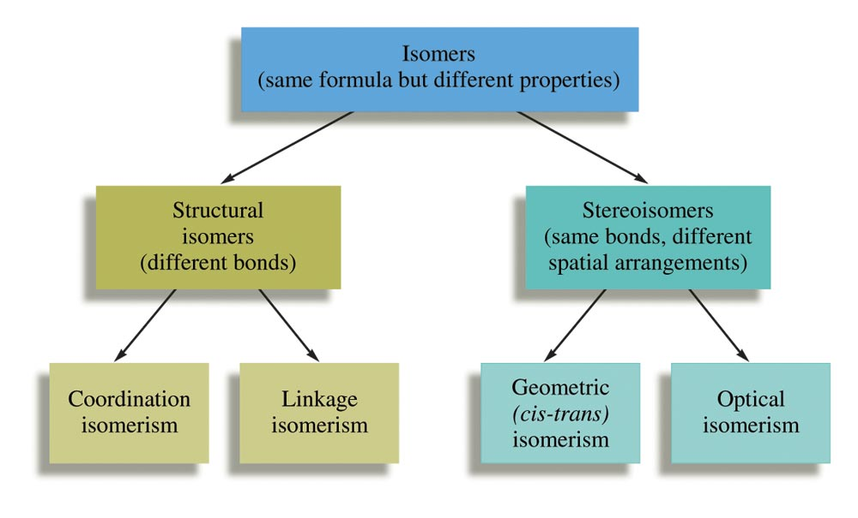
Some Classes of Isomers

Slide 83
Structural Isomerism
Coordination Isomerism:
Composition of the complex ion varies.
[Cr(NH₃)₅SO₄]Br and [Cr(NH₃)₅Br]SO₄
Linkage Isomerism:
Composition of the complex ion is the same, but the point of attachment of at least one of the ligands differs.

Slide 84
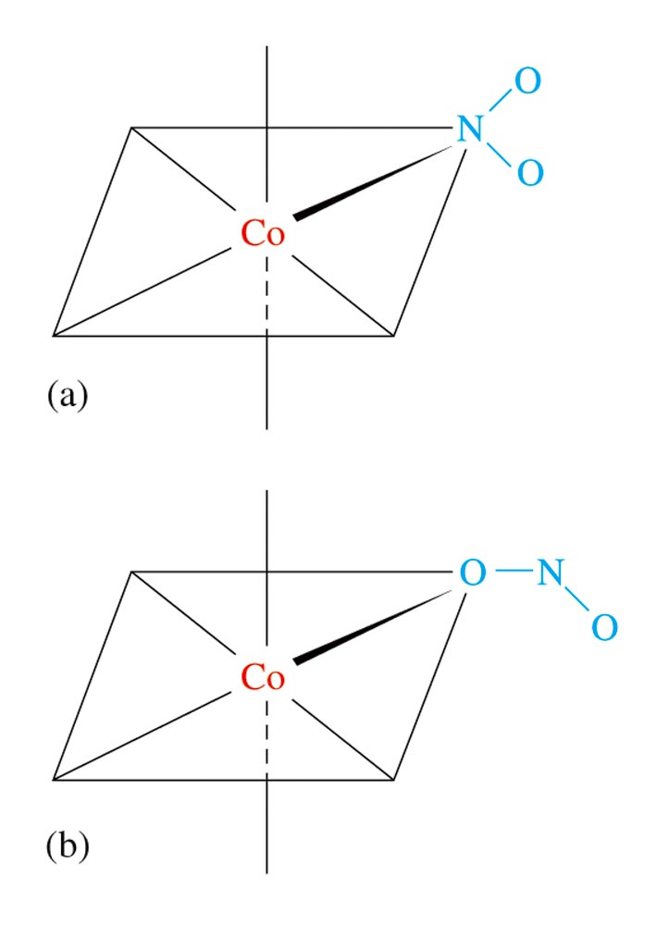
Linkage Isomerism of NO₂–

Slide 85
Stereoisomerism
Geometrical Isomerism (cis-trans):
Atoms or groups of atoms can assume different positions around a rigid ring or bond.
Cis – same side (next to each other)
Trans – opposite sides (across from each other)

Slide 86
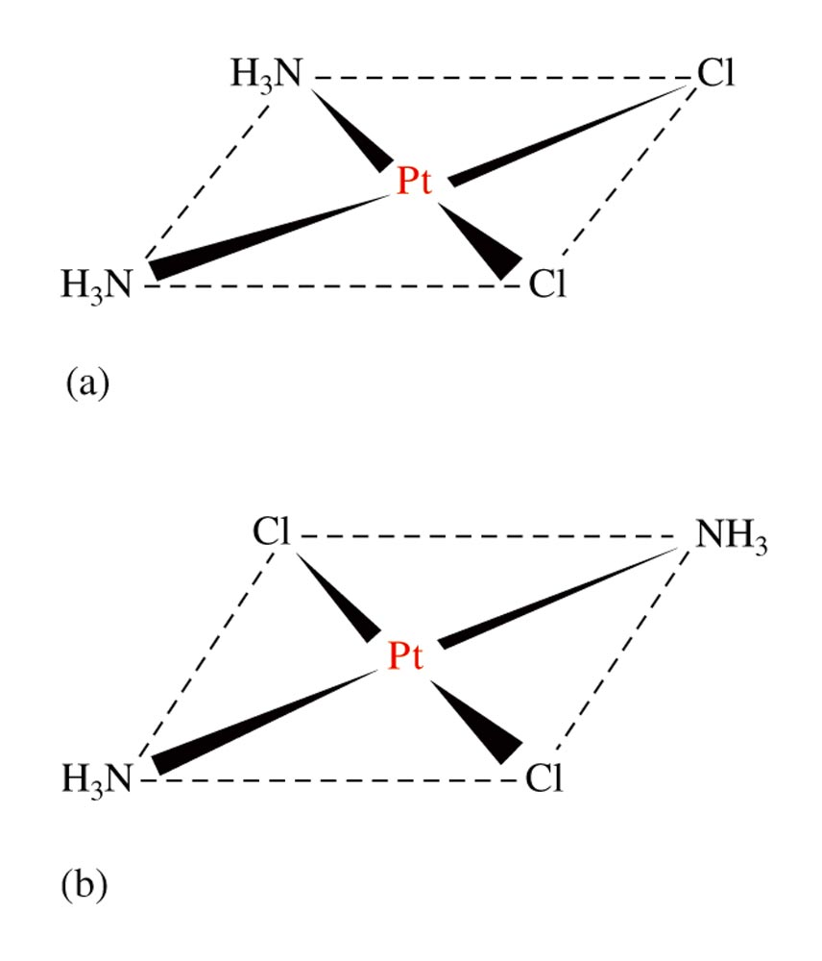
Geometrical (cis-trans) Isomerism for a Square Planar Compound (a) cis isomer (b) trans isomer

Slide 87
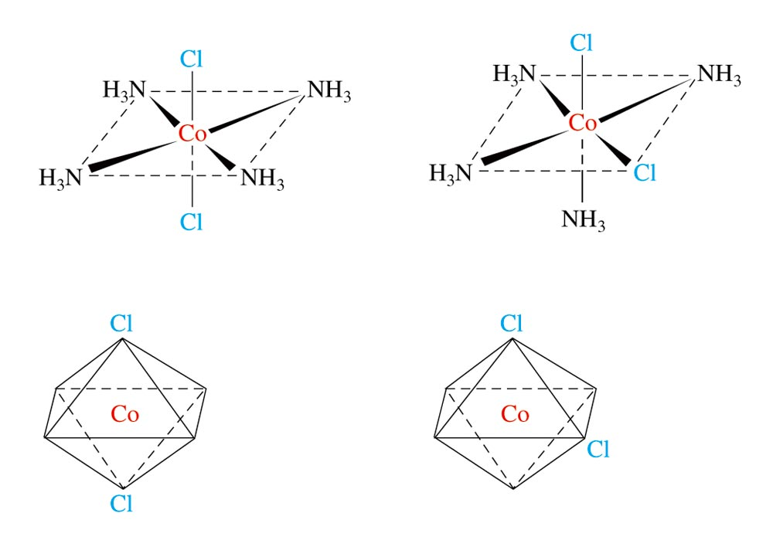
Geometrical (cis-trans) Isomerism for an Octahedral Complex Ion

Slide 88
Stereoisomerism
Optical Isomerism:
Isomers have opposite effects on plane-polarized light.

Slide 89
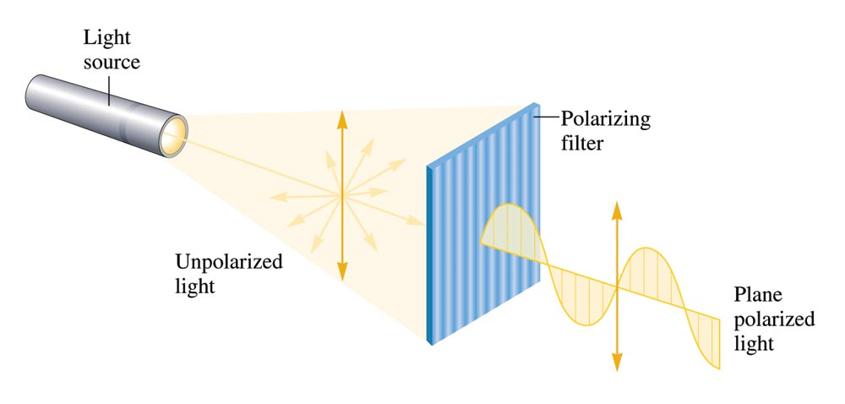
Unpolarized Light Consists of Waves Vibrating in Many Different Planes

Slide 90
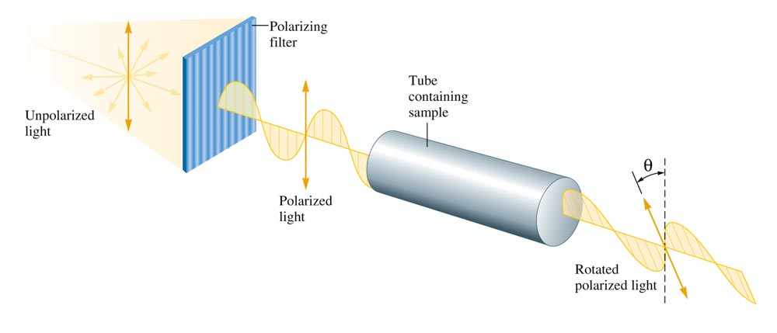
The Rotation of the Plane of Polarized Light by an Optically Active Substance

Slide 91
Optical Activity
Exhibited by molecules that have nonsuperimposable mirror images (chiral molecules).
Enantiomers – isomers of nonsuperimposable mirror images.

Slide 92

A Human Hand Exhibits a Nonsuperimposable Mirror Image

Slide 93
Does [Co(en)₂Cl₂]Cl exhibit geometrical isomerism?
Yes
Does it exhibit optical isomerism?
Trans form – No
Cis form – Yes
Notes:
See Figure 21.17. [Co(en)₂Cl₂]Cl exhibits geometrical isomerism (trans and cis forms). The trans form does not exhibit optical isomerism but the cis form does exhibit optical isomerism.

Slide 94
Bonding in Complex Ions
The VSEPR model for predicting structure generally does not work for complex ions.
However, assume a complex ion with a coordination number of 6 will have an octahedral arrangement of ligands.
And, assume complexes with two ligands will be linear.
But, complexes with a coordination number of 4 can be either tetrahedral or square planar.

Slide 95
Bonding in Complex Ions
2. The interaction between a metal ion and a ligand can be viewed as a Lewis acid–base reaction with the ligand donating a lone pair of electrons to an empty orbital of the metal ion to form a coordinate covalent bond.

Slide 96
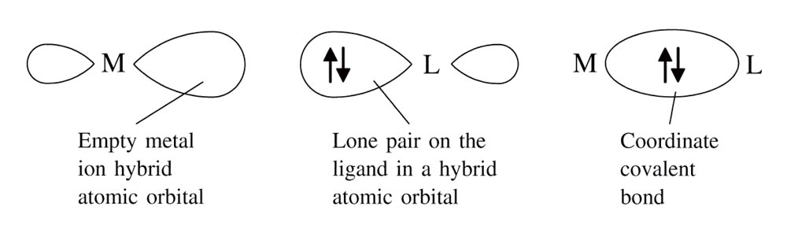
The Interaction Between a Metal Ion and a Ligand Can Be Viewed as a Lewis Acid-Base Reaction

Slide 97
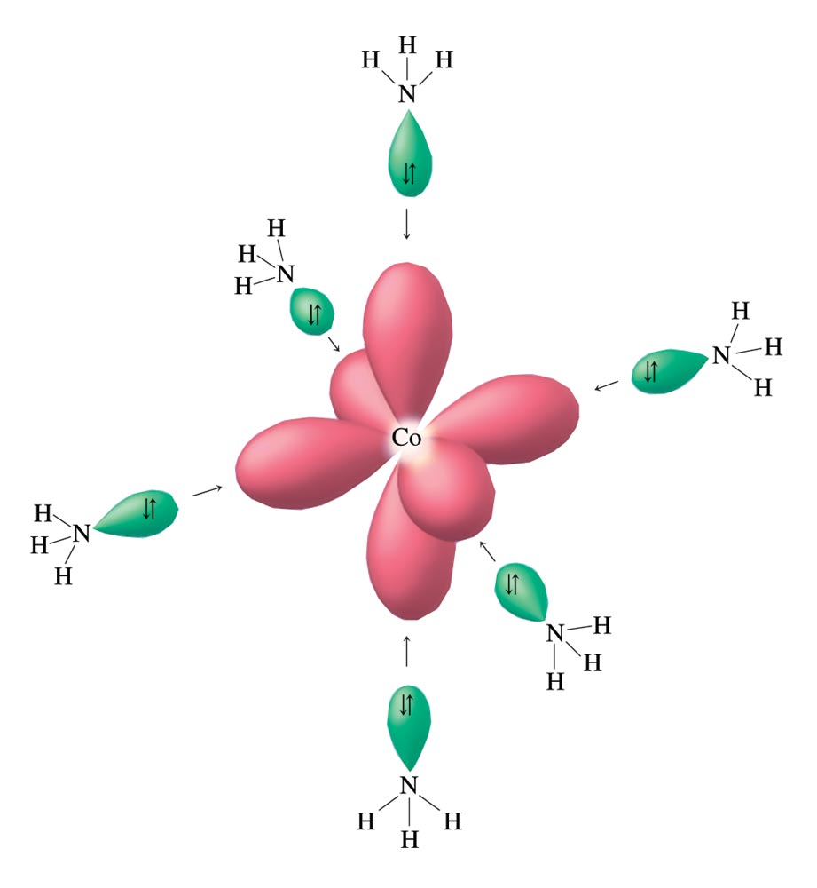
Hybrid Orbitals on Co³⁺ Can Accept an Electron Pair from Each NH₃ Ligand

Slide 98
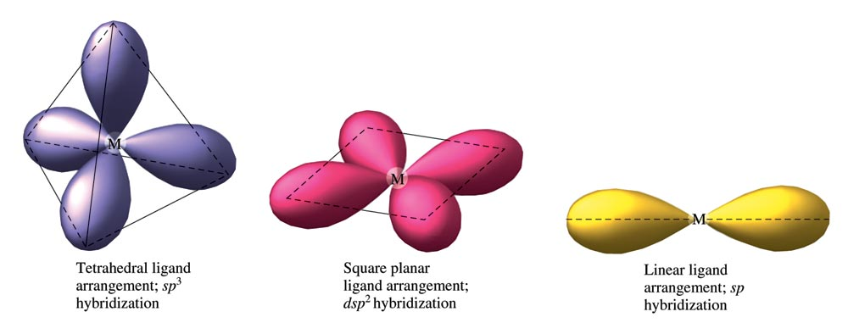
The Hybrid Orbitals Required for Tetrahedral, Square Planar, and Linear Complex Ions

Slide 99
Crystal Field Model
Focuses on the effect of ligands on the energies of the d orbitals of metals.
Assumptions
Ligands are negative point charges.
Metal–ligand bonding is entirely ionic:
strong-field (low–spin):
large splitting of d orbitals
weak-field (high–spin):
small splitting of d orbitals

Slide 100
Octahedral Complexes
point their lobes directly at the point-charge ligands.
point their lobes between the point charges.

Slide 101
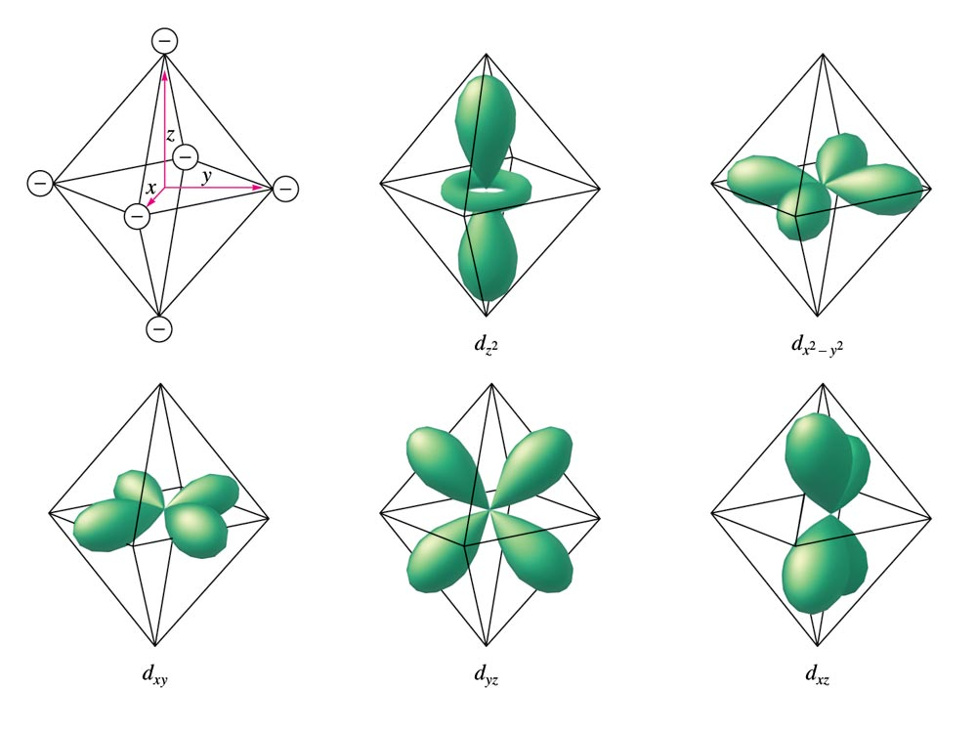
An Octahedral Arrangement of Point-Charge Ligands and the Orientation of the 3d Orbitals

Slide 102
Which Type of Orbital is Lower in Energy?
Because the negative point-charge ligands repel negatively charged electrons, the electrons will first fill the d orbitals farthest from the ligands to minimize repulsions.
The orbitals are at a lower energy in the octahedral complex than are the orbitals.

Slide 103
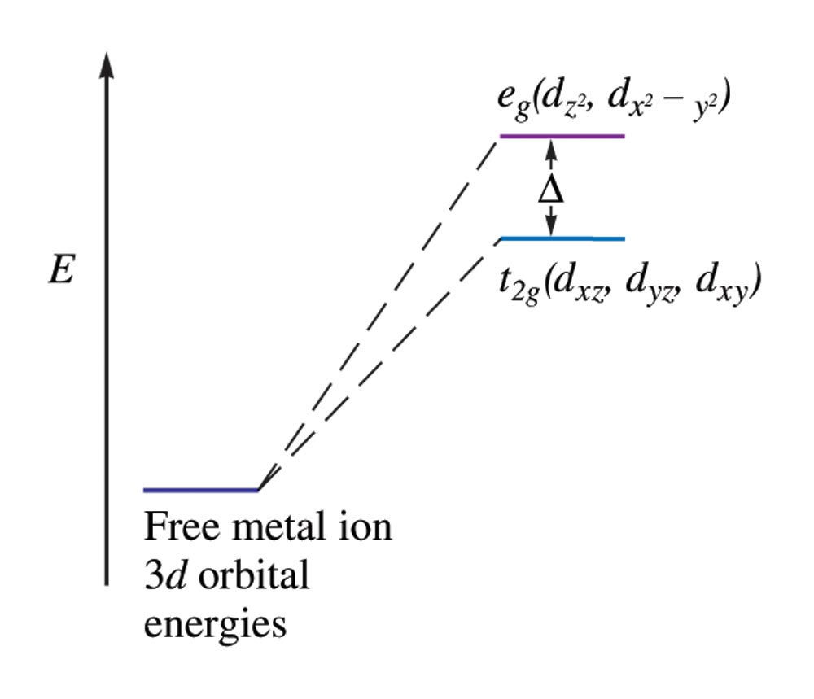
The Energies of the 3d Orbitals for a Metal Ion in an Octahedral Complex

Slide 104
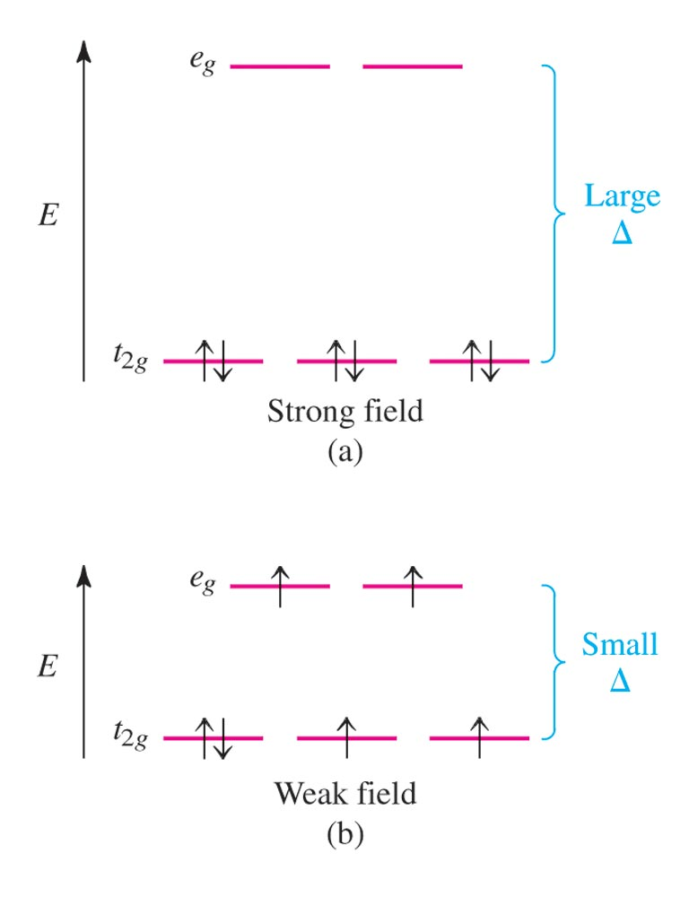
Possible Electron Arrangements in the Split 3d Orbitals in an Octahedral Complex of Co³⁺

Slide 105
Magnetic Properties
Strong–field (low–spin):
Yields the minimum number of unpaired electrons.
Weak–field (high–spin):
Gives the maximum number of unpaired electrons.
Hund’s rule still applies.

Slide 106
Spectrochemical Series
Strong–field ligands to weak–field ligands.
(large split) (small split)
CN– > NO₂– > en > NH₃ > H₂O > OH– > F– > Cl– > Br– > I–
Magnitude of split for a given ligand increases as the charge on the metal ion increases.

Slide 107
Complex Ion Colours
When a substance absorbs certain wavelengths of light in the visible region, the colour of the substance is determined by the wavelengths of visible light that remain.
Substance exhibits the colour complementary to those absorbed.

Slide 108
Complex Ion Colours
The ligands coordinated to a given metal ion determine the size of the d–orbital splitting, thus the colour changes as the ligands are changed.
A change in splitting means a change in the wavelength of light needed to transfer electrons between the t_{2g} and e_{g} orbitals.

Slide 109
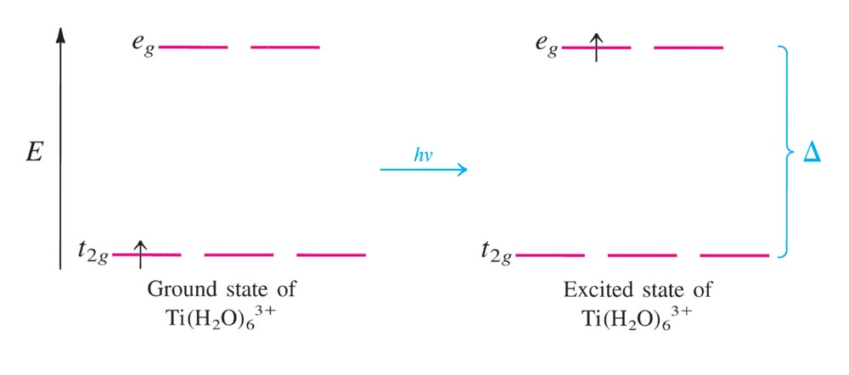
Absorbtion of Visible Light by the Complex Ion Ti(H₂O)₆³⁺

Slide 110
Which of the following are expected to form colourless octahedral compounds?
Ti⁴⁺ Cr³⁺ Mn²⁺
Fe²⁺ Fe³⁺ Co²⁺
Co³⁺ Ni²⁺ Cu⁺
Cu²⁺ Zn²⁺ Ag⁺
Notes:
There are 4 colorless octahedral compounds. These are either d¹⁰ ions (Zn²⁺, Cu⁺, Ag⁺), or the d⁰ ion (Ti⁴⁺). If electrons cannot move from one energy level to the next in the energy level diagram, there is no color absorbed.

Slide 111
Tetrahedral Arrangement
None of the 3d orbitals “point at the ligands”.
Difference in energy between the split d orbitals is significantly less.
d–orbital splitting will be opposite to that for the octahedral arrangement.
Weak–field case (high–spin) always applies.

Slide 112
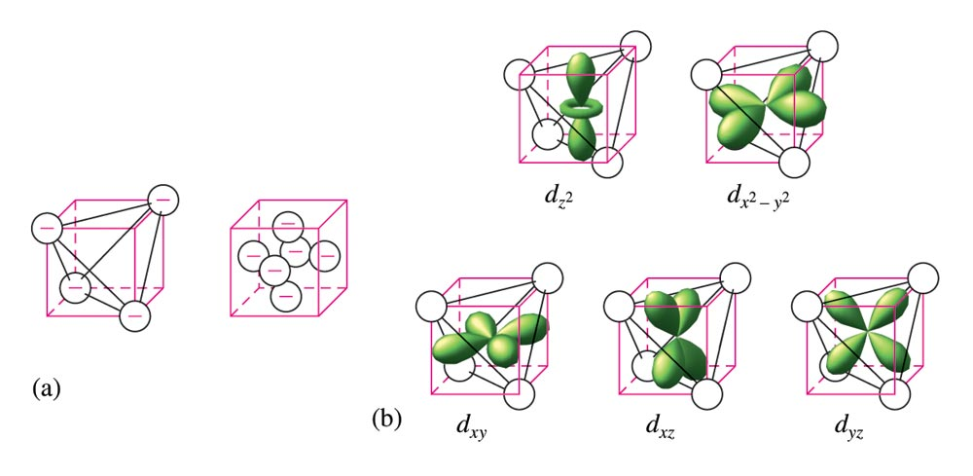
The d Orbitals in a Tetrahedral Arrangement of Point Charges

Slide 113
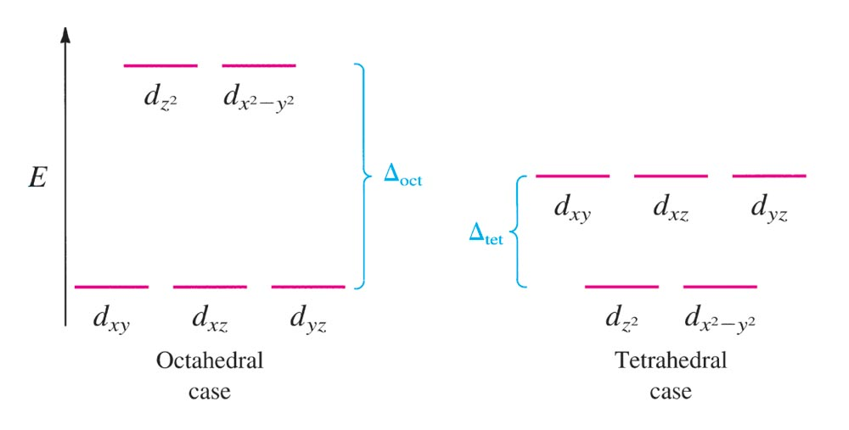
The Crystal Field Diagrams for Octahedral and Tetrahedral Complexes

Slide 114
Consider the Crystal Field Model (CFM).
Which is lower in energy, d–orbital lobes pointing toward ligands or between? Why?
The electrons in the d–orbitals – are they from the metal or the ligands?
Notes:
In all cases these answers explain the crystal field model. The molecular orbital model is a more powerful model and explains things differently. However, it is more complicated. This is another good time to discuss the role of models in science.
a) Lobes pointing between ligands are lower in energy because we assume ligands are negative point charges. Thus, orbitals (with electron probability) pointing at negative point charges will be relatively high in energy.
b) The electrons are from the metal.

Slide 115
Consider the Crystal Field Model (CFM).
Why would electrons choose to pair up in d–orbitals instead of being in separate orbitals?
Why is the predicted splitting in tetrahedral complexes smaller than in octahedral complexes?
Notes:
c) Since some orbitals are higher in energy than others (see "a"), electrons may actually be lower in energy by pairing up than by jumping up in energy to be in a separate orbital.
d) In an octahedral geometry there are some orbitals pointing directly at ligands. Thus, there is a greater energy difference between these (larger splitting).

Slide 116
Using the Crystal Field Model, sketch possible electron arrangements for the following. Label one sketch as strong field and one sketch as weak field.
Ni(NH₃)₆²⁺
Fe(CN)₆^{3–}
Co(NH₃)₆³⁺
Notes:
a) A d ⁸ ion will look the same as strong field or weak field in an octahedral complex. In each case there are two unpaired electrons.
b) This is a d ⁵ ion. In the weak field case, all five electrons are unpaired. In the strong field case, there is one unpaired electron.
c) This is a d ⁶ ion. In the weak field case, there are four unpaired electrons. In the strong field case, there are no unpaired electrons.

Slide 117
A metal ion in a high–spin octahedral complex has 2 more unpaired electrons than the same ion does in a low–spin octahedral complex.
What are some possible metal ions for which this would be true?
Metal ions would need to be d⁴ or d⁷ ions. Examples include Mn³⁺, Co²⁺, and Cr²⁺.
Notes:
Metal ions would need to be d⁴ or d⁷ ions. Examples include Mn³⁺, Co²⁺, and Cr²⁺.

Slide 118
Between [Mn(CN)₆]^{3–} and [Mn(CN)₆]^{4–} which is more likely to be high spin? Why?
Notes:
[Mn(CN)₆]⁴⁻ is more likely to be high spin because the charge on the Mn ion is 2+ while the [Mn(CN)₆]³⁻ the charge on the Mn ion is 3+. With a larger charge, there is bigger splitting between energy levels, meaning strong field, or low spin.

Slide 119
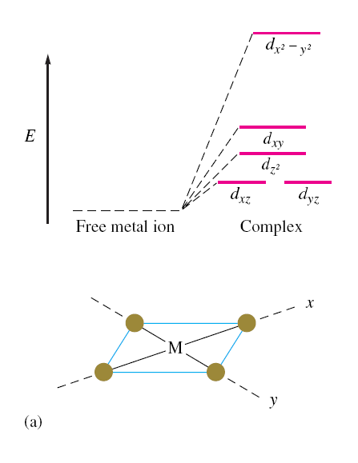
The d Energy Diagrams for Square Planar Complexes

Slide 120
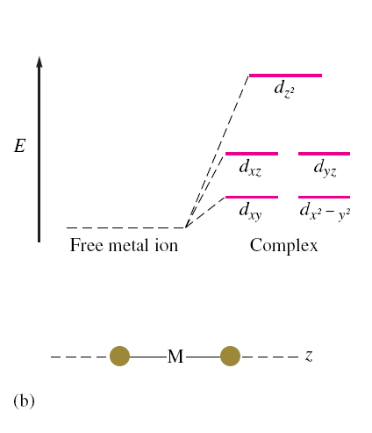
The d Energy Diagrams for Linear Complexes Where the Ligands Lie Along the z Axis

Slide 121
Transition Metal Complexes in Biological Molecules
Metal ion complexes are used in humans for the transport and storage of oxygen, as electron-transfer agents, as catalysts, and as drugs.

Slide 122
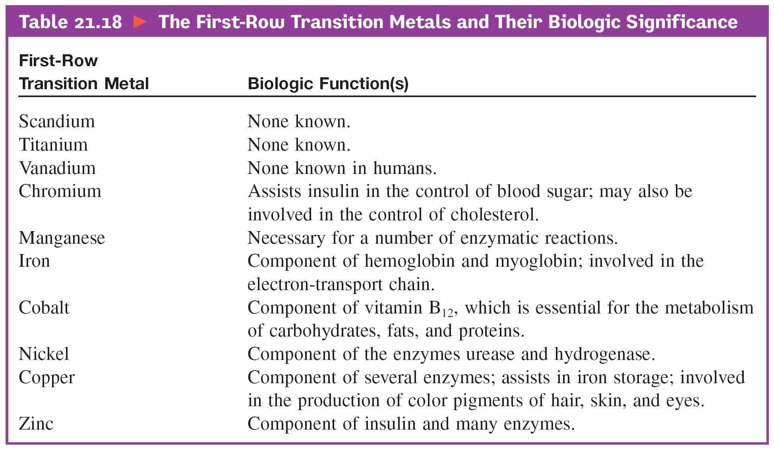
First-Row Transition Metals and Their Biological Significance

Slide 123
Biological Importance of Iron
Plays a central role in almost all living cells.
Component of hemoglobin and myoglobin.
Involved in the electron-transport chain.

Slide 124
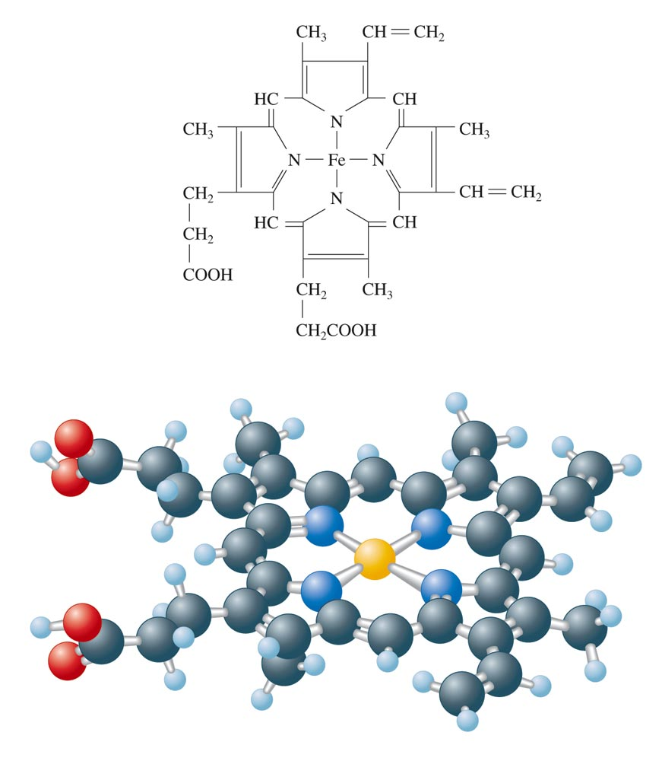
The Heme Complex

Slide 125
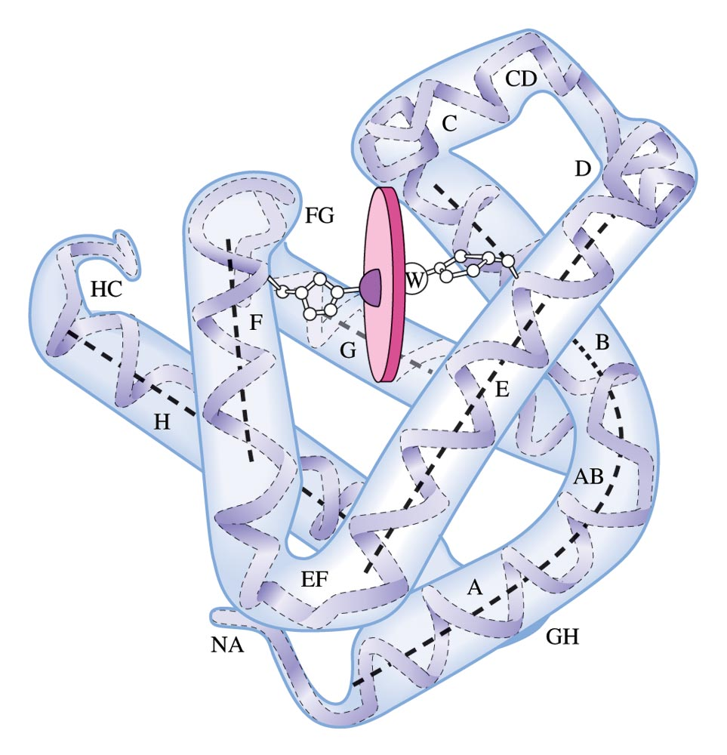
Myoglobin
The Fe²⁺ ion is coordinated to four nitrogen atoms in the porphyrin of the heme (the disk in the figure) and on nitrogen from the protein chain.
This leaves a 6th coordination position (the W) available for an oxygen molecule.

Slide 126

Polydentate Ligands
Chelating agents generally form more stable complexes than do monodentate ligands.

Slide 127

Chelating Agents
5-
-
..
..
-
:
:
..
..
:
:
:
:
:
:
..
..
..
-
-
-
Bind to metal ions removing them from solution.
Phosphates are used to tie up Ca²⁺ and Mg²⁺ in hard water to prevent them from interfering with detergents.

Slide 128

Chelating Agents
Porphyrins are complexes containing a form of the porphine molecule shown at right.
Important biomolecules like heme and chlorophyll are porphyrins.

Slide 129

Chelating Agents
Porphines (like chlorophyll a) are tetradentate ligands.

Slide 130

Metal complexes and color
The ligands of a metal complex effect its color
Addition of NH₃ ligand to Cu(H₂O)₄ changes its color
Notes:
Figure: 24-22
Title:
Effect of ligands on color.
Caption:
An aqueous solution of CuSO₄ is pale blue because of [Cu(H₂O)₄]²⁺ (left). When NH₃(aq) is added (middle and right), the deep blue [Cu(NH₃)₄]²⁺ ion forms.

Slide 131

Why does anything have color?
Light of different frequencies give different colors
We learned that elements can emit light of different frequency or color.
But these coordination complexes are not emitting light
They absorb light.
How does that give color?
Notes:
Figure: 24-23
Title:
Visible spectrum.
Caption:
The relationship between color and wavelength for visible light.

Slide 132
Light can bounce off an object or get absorbed by object
No light absorbed, all reflected get white color
All light absorbed, none reflected get Black color
What if only one color is absorbed?

Slide 133

Complimentary color wheel
If one color absorbed, the color opposite is perceived.
Absorb Orange
See Blue
Absorb Red
See Green
Notes:
Figure: 24-24
Title:
Artist's color wheel.
Caption:
Colors with approximate wavelength ranges are shown as wedges. The colors that are complementary to each other lie opposite each other.

Slide 134

[Ti(H₂O)₆]³⁺
Absorbs in green yellow.
Looks purple.
Notes:
Figure: 24-26
Title:
The color of [Ti(H₂O)₆]³⁺.
Caption:
(a) A solution containing the [Ti(H₂O)₆]³⁺ ion. (b) The visible absorption spectrum of the [Ti(H₂O)₆]³⁺ ion.

Slide 135

A precise measurement of the absorption spectrum of Compounds is critical
Notes:
Figure: 24-25
Title:
Experimental determination of the absorption spectrum of a solution.
Caption:
The prism is rotated so that different wavelengths of light pass through the sample. The detector measures the amount of light reaching it, and this information can be displayed as the absorption at each wavelength. The absorbance is a measure of the light absorbed.

Slide 136
Metal complexes and color
But why do different ligands on same metal give
Different colors?
Why do different ligands change absorption?
Addition of NH₃ ligand to Cu(H₂O)₄ changes its color
Notes:
Figure: 24-22
Title:
Effect of ligands on color.
Caption:
An aqueous solution of CuSO₄ is pale blue because of [Cu(H₂O)₄]²⁺ (left). When NH₃(aq) is added (middle and right), the deep blue [Cu(NH₃)₄]²⁺ ion forms.

Slide 137

Model of ligand/metal bonding.
Electron pair comes from ligand
Bond very polarized.
Assumption: interaction pure electrostatic.
Notes:
Figure: 24-27
Title:
Metal-ligand bond formation.
Caption:
The ligand, which acts as a Lewis base, donates charge to the metal via a metal hybrid orbital. The bond that results is strongly polar, with some covalent character. It is often sufficient to assume that the metal-ligand interaction is entirely electrostatic in character, as is done in the crystal-field model.

Slide 138

Now, think of point charges being attracted to metal nucleus
Positive charge. What about electrons in d orbitals?
Ligand negative charge
Is repelled by d electrons, d orbital energy goes up
Notes:
Figure: 24-28
Title:
Energies of d orbitals in an octahedral crystal field.
Caption:
On the left the energies of the d orbitals of a free ion are shown. When negative charges are brought up to the ion, the average energy of the d orbitals increases (center). On the right the splitting of the d orbitals due to the octahedral field is shown. Because the repulsion felt by the d_{z2} and d_{x2–y2} orbitals is greater than that felt by the d_{xy}, d_{xz}, and d_{yz} orbitals, the five d orbitals split into a lower-energy set of three (the t₂ set) and a higher-energy set of two (the e set).

Slide 139

Ligands will interact with some d orbitals more than others
Depends on relative orientation of orbital and ligand
Ligands point right at lobes
Notes:
Figure: 24-29abc
Title:
The five d orbitals in an octahedral crystal field.
Caption:
(a) An octahedral array of negative charges approaching a metal ion. (b) The orientations of the d orbitals relative to the negative charges. Notice that the lobes of the d_{z2} and d_{x2–y2} orbitals (b and c) point toward the charges, whereas the lobes of the d_{xy}, d_{yz}, and d_{xz} orbitals (d–f) point between the charges.

Slide 140

In these orbitals, the ligands are between the lobes
Interact less strongly
Notes:
Figure: 24-29def
Title:
The five d orbitals in an octahedral crystal field.
Caption:
(a) An octahedral array of negative charges approaching a metal ion. (b) The orientations of the d orbitals relative to the negative charges. Notice that the lobes of the d_{z2} and d_{x2–y2} orbitals (b and c) point toward the charges, whereas the lobes of the d_{xy}, d_{yz}, and d_{xz} orbitals (d–f) point between the charges.

Slide 141
Splitting due to ligand/orbirtal orientation.

Slide 142

= 495 nm
Notes:
Figure: 24-30
Title:
Electronic transition accompanying absorption of light.
Caption:
The 3d electron of [Ti(H₂O)₆]³⁺ is excited from the lower-energy d orbitals to the higher-energy ones when irradiated with light of 495-nm wavelength.

Slide 143

Different ligands interact more or less, change E spacing
Of D orbitals.
Notes:
Figure: 24-31
Title:
Effect of ligand on crystal-field splitting.
Caption:
This series of octahedral chromium(III) complexes illustrates how Δ, the energy gap between the t₂ and e orbitals, increases as the field strength of the ligand increases.

Slide 144
Spectrochemical series (strength of ligand interaction)
Increasing Δ
Cl⁻ < F⁻ < H₂O < NH₃ < en < NO₂⁻ < CN⁻
Increasing Δ

Slide 145

Electron configurations of some octahedral complexes
Notes:
eleFigure: 24-32
Title:
Electron configurations in octahedral complexes.
Caption:
Orbital occupancies are shown for complexes with one, two, and three d electrons in an octahedral crystal field.

Slide 146

As Energy difference increases, electron configuration
changes
“Low spin”
“High spin”
Co(III) is d⁶
Notes:
Figure: 24-33
Title:
High-spin and low-spin complexes.
Caption:
Population of d orbitals in the high-spin [CoF₆]^{3–} ion (small Δ)and low-spin [Co(CN)₆]^{3–} ion (large Δ). Both complexes contain cobalt(III), which has six 3d electrons, 3d⁶.

Slide 147

Notes:
Figure: 24-33-01UN
Title:
Sample Exercise 24.9
Caption:
Orbital diagrams.

Slide 148

Tetrahedral Complexes
In tetrahedral complexes, orbitals are inverted.
Again because of orientation of orbitals and ligands
Δ is always small, always low spin (less ligands)
Notes:
Figure: 24-34
Title:
Tetrahedral crystal field.
Caption:
Energies of the d orbitals in a tetrahedral crystal field

Slide 149

Square planar complexes are different still
Notes:
Figure: 24-35
Title:
Energies of the d orbitals in a square-planar crystal field.
Caption:
The boxes on the left show the energies of the d orbitals in an octahedral crystal field. As the two negative charges along the z-axis are removed, the energies of the d orbitals change, as indicated by the lines between the boxes. When the charges are completely removed, the square-planar geometry results, giving the splitting of d-orbital energies represented by the boxes on the right.

Slide 150




Slide 151

Notes:
Figure: 24-35-01UNEx10
Title:
Sample Exercise 24.10
Caption:
Orbital diagrams of tetrahedral and square planar–complexes.

Slide 152

Intense color can come from “charge transfer”
Ligand electrons jump to metal orbitals
KMnO₄
KCrO₄
KClO₄
No d orbitals in
Cl, orbitals higher
In energy
Notes:
Figure: 24-36
Title:
Effect of charge-transfer transitions.
Caption:
The compounds KMnO₄, K₂CrO₄, and KClO₄ are shown from left to right. The KMnO₄ and K₂CrO₄ are intensely colored because of ligand-to-metal charge transfer (LMCT) transitions in the MnO₄– and CrO₄^{2–} anions. There are no valence d orbitals on Cl, so the charge-transfer transition for ClO₄– requires ultraviolet light and KClO₄ is white.

Slide 153

Notes:
Figure: 24-37
Title:
Ligand-to-metal charge transfer (LMCT) transition in MnO₄–.
Caption:
As shown by the blue arrow, an electron is excited from a nonbonding pair on O into one of the empty d orbitals on Mn.

Slide 154
Exam 4, MO theory and coordination compounds
Chapter 9, end and Chapter 24.
MO theory: Rules:
1. The number of MO’s equals the # of Atomic orbitals
2. The overlap of two atomic orbitals gives two molecular orbitals, 1 bonding, one antibonding
3. Atomic orbitals combine with other atomic orbitals of similar energy.
4. Degree of overlap matters. More overlap means bonding orbital goes lower in E, antibonding orbital goes higher in E.
5. Each MO gets two electrons
6. Orbitals of the same energy get filled 1 electron at a time until they are filled.

Slide 155

Difference between pi and sigma orbitals
End on
Side to side.

Slide 156

A typical MO diagram, like the one below. For 2p and 2s atomic orbital mixing.

Slide 157

Oxygen O₂ is Paramagnetic, why?

Slide 158

Show me why.

Slide 159
There is also splitting from tetrahedral
And square planar. Know they are different, don’t remember exactly what they are like.

Slide 160


Slide 161


Slide 162


Slide 163
Crystal Field Theory
Focus: energies of the d orbitals
Assumptions
1. Ligands: negative point charges
2. Metal-ligand bonding: entirely ionic
strong-field (low-spin): large splitting of d orbitals
weak-field (high-spin): small splitting of d orbitals

Slide 164


Slide 165


Slide 166
Δ = crystal field splitting

Slide 167

High spin
Low spin

Slide 168
Placing electrons in d orbitals
d⁵
d⁶
d⁷
1 u.e.
5 u.e.
0 u.e.
4 u.e.
1 u.e.
3 u.e.
d⁸
d⁹
d¹⁰
2 u.e.
2 u.e.
1 u.e.
1 u.e.
0 u.e.
0 u.e.

Slide 169

Positive favors high spin. Neg favors low spin.

Slide 170
Enthalpy of Hydration of hexahydrate

Slide 171
Splitting of d orbitals in a tetrahedral field
t₂
Δt
e
Δ_{t} = 4/9Δ_{o}
Always weak field (high spin)

Slide 172
Magnetic properties of metal complexes
Diamagnetic complexes
very small repulsive interaction with external magnetic field
no unpaired electrons
Paramagnetic complexes
attractive interaction with external magnetic field
some unpaired electrons

Slide 173

Measured magnetic moments include contributions from both spin and orbital spin. In the first transition series complexes the orbital contribution is small and usually ignored.

Slide 174
Coordination Chemistry:
Molecular orbitals for metal complexes

Slide 175



The symmetry of metal orbitals in an octahedral environment
A_{1g}
T_{1u}

Slide 176

The symmetry of metal orbitals in an octahedral environment
T_{2g}
E_{g}

Slide 177

The symmetry of metal orbitals in an octahedral environment
s

Slide 178
Metal-ligand σ interactions in an octahedral environment
Six ligand orbitals of σ symmetry approaching the metal ion along the x,y,z axes
We can build 6 group orbitals of σ symmetry as before
and work out the reducible representation

Slide 179

s
If you are given Γ, you know by now how to get the irreducible representations
Γ = A_{1g} + T_{1u} + E_{g}

Slide 180
Now we just match the orbital symmetries
s

Slide 181

“d⁰-d¹⁰ electrons”
anti bonding
“metal character”
non bonding
6 σ ligands x 2e each
12 σ bonding e
“ligand character”

Slide 182


Introducing π-bonding
2 orbitals of π-symmetry
on each ligand
We can build 12 group orbitals
of π-symmetry

Slide 183

Γ_{π} = T_{1g} + T_{2g} + T_{1u} + T_{2u}

Slide 184

Anti-bonding LUMO(π)
The CN- ligand

Slide 185

Some schematic diagrams showing how p bonding occurs with a ligand having a d orbital (P), a π* orbital, and a vacant p orbital.

Slide 186
ML₆ σ-only bonding
“d⁰-d¹⁰ electrons”
anti bonding
“metal character”
non bonding
The bonding orbitals, essentially the ligand lone pairs,
will not be worked with further.
6 σ ligands x 2e each
12 σ bonding e
“ligand character”

Slide 187
π-bonding may be introduced
as a perturbation of the t_{2g}/e_{g} set:
Case 1 (CN⁻, CO, C₂H₄)
empty π-orbitals on the ligands
M→L π-bonding (π-back bonding)
t_{2g} (π*)
t_{2g}
e_{g}
e_{g}
Δo
Δ’o
Δ_{o} has increased
t_{2g}
Stabilization
t_{2g} (π)
ML₆
σ-only
ML₆
σ + π
(empty π-orbitals on ligands)

Slide 188
π-bonding may be introduced
as a perturbation of the t_{2g}/e_{g} set.
Case 2 (Cl⁻, F⁻)
filled π-orbitals on the ligands
L→M π-bonding
e_{g}
e_{g}
Δ’o
t_{2g} (π*)
Δ_{o} has decreased
Δo
Destabilization
t_{2g}
t_{2g}
Stabilization
t_{2g} (π)
ML₆
σ-only
ML₆
σ + π
(filled π-orbitals)

Slide 189

Putting it all on one diagram.
Strong field / low spin
Weak field / high spin

Slide 190
Spectrochemical Series
Purely σ ligands:
Δ: en > NH₃ (order of proton basicity)
donating which decreases splitting and causes high spin:
Δ: H₂O > F > RCO₂ > OH > Cl > Br > I (also proton basicity)
Adding in water, hydroxide and carboxylate
Δ: H₂O > F > RCO₂ > OH > Cl > Br > I
π accepting ligands increase splitting and may be low spin
Δ: CO, CN⁻, > phenanthroline > NO₂⁻ > NCS⁻

Slide 191
Merging to get spectrochemical series
CO, CN⁻ > phen > en > NH₃ > NCS⁻ > H₂O > F⁻ > RCO₂⁻ > OH⁻ > Cl⁻ > Br⁻ > I⁻
Weak field, π donors small Δ high spin
Strong field, π acceptors large Δ low spin
σ only

Slide 192
Turning to Square Planar Complexes
Most convenient to use a local coordinate system on each ligand with
y pointing in towards the metal. p_{y} to be used for σ bonding.
z being perpendicular to the molecular plane. p_{z} to be used for π bonding perpendicular to the plane, π⊥.
x lying in the molecular plane. p_{x} to be used for π bonding in the molecular plane, π|.

Slide 193

ML₄ square planar complexes
ligand group orbitals and matching metal orbitals

Slide 194




ML₄ square planar complexes
MO diagram
σ-only bonding
π- bonding

Slide 195

A crystal-field aproach: from octahedral to tetrahedral
Less repulsions along the axes
where ligands are missing

Slide 196

A crystal-field aproach: from octahedral to tetrahedral
A correction to preserve
center of gravity

Slide 197
The Jahn-Teller effect
Jahn-Teller theorem:
“there cannot be unequal occupation of orbitals with identical energy”
Molecules will distort to eliminate the degeneracy

Slide 198



Slide 199
Angular Overlap Method
An attempt to systematize the interactions for all geometries.
The various complexes may be fashioned out of the ligands above
Linear: 1,6
Trigonal: 2,11,12
T-shape: 1,3,5
Tetrahedral: 7,8,9,10
Square planar: 2,3,4,5
Trigonal bipyramid: 1,2,6,11,12
Square pyramid: 1,2,3,4,5
Octahedral: 1,2,3,4,5,6

Slide 200
Cont’d
All σ interactions with the ligands are stabilizing to the ligands and destabilizing to the d orbitals. The interaction of a ligand with a d orbital depends on their orientation with respect to each other, estimated by their overlap which can be calculated.
The total destabilization of a d orbital comes from all the interactions with the set of ligands.
For any particular complex geometry we can obtain the overlaps of a particular d orbital with all the various ligands and thus the destabilization.

Slide 201
ligand | d_{z2} | d_{x2-y2} | d_{xy} | d_{xz} | d_{yz}
1 | 1 e_{σ} | 0 | 0 | 0 | 0
2 | ¼ | ¾ | 0 | 0 | 0
3 | ¼ | ¾ | 0 | 0 | 0
4 | ¼ | ¾ | 0 | 0 | 0
5 | ¼ | ¾ | 0 | 0 | 0
6 | 1 | 0 | 0 | 0 | 0
7 | 0 | 0 | 1/3 | 1/3 | 1/3
8 | 0 | 0 | 1/3 | 1/3 | 1/3
9 | 0 | 0 | 1/3 | 1/3 | 1/3
10 | 0 | 0 | 1/3 | 1/3 | 1/3
11 | ¼ | 3/16 | 9/16 | 0 | 0
12 | 1/4 | 3/16 | 9/16 | 0 | 0
Thus, for example a d_{x2-y2} orbital is destabilized by (3/4 +6/16) e_{σ} = 18/16 e_{σ} in a trigonal bipyramid complex due to σ interaction. The d_{xy}, equivalent by symmetry, is destabilized by the same amount. The d_{z2} is destabililzed by 11/4 e_{σ}.

Slide 202
Solid State (10 h)

Slide 203
The Solid State
Crystalline and Amorphous Solids

Slide 204

Crystalline and Amorphous Solids
Crystalline and amorphous are the two major categories into which solids are divided.
Crystalline solids exhibit long-range order in their atomic arrangements.

Slide 205

The order in crystals is usually three dimensional, but lower dimensionality order is possible.
Bonds in crystalline solids are more or less the same in energy, and crystalline solids have distinct melting temperature.
mercury

Slide 206

Amorphous solids exhibit only short-range order in their atomic arrangements. They lack long-range order.
Their bonds vary in energy and are weaker; they have no distinct melting temperature.
A good example is B₂O₃. For crystalline B₂0₃.
All crystals have atoms which are “equivalent;” the symmetry of all equivalent atoms is the same.
For example, these two boron atoms are equivalent; everything around them looks the same.

Slide 207
Here’s how you tell if a solid is crystalline:
Imagine you are a nanohuman. If you build a house on some boron atom and look out any window in some direction…
You’ll have exactly the same view if you build your house on an equivalent boron atom and look out in an equivalent direction.
Note that “equivalent direction” does not mean “the same direction.”

Slide 208

for amorphous B₂O₃.
Every B is surrounded by a “triangle” of 3 O’s, just as for crystalline B₂O₃.
But you can’t find two B atoms that give you an identical “view.” Eventually the short-range order breaks down, and every “view” is different.
“Amorphous” means “formless” or “shapeless” but amorphous materials still have short-range order. The appropriate definition of “amorphous” for us is “lacking a distinct crystalline structure.”

Slide 209

Defects in Crystals

Slide 210
It's easy to think of real crystals as having these ideal structures.
In fact, no crystals are perfect; all crystals have defects. Crystals can have:
• The "right" atoms in "wrong" places.
• "Wrong" atoms in "right" or "wrong" places.
• Missing atoms.
• Etc.
One type of defect is the point defect.

Slide 211
There are three basic kinds of point defects.
• (1) A vacancy.
Actually, a vacancy would probably look more like this:

Slide 212
• (2) An interstitial.
There is likely a vacancy somewhere else in the crystal, which supplied the interstitial atom.

Slide 213
• (3) An impurity,
• (3) An impurity, which could be either substitutional
• (3) An impurity, which could be either substitutional or interstitial.
substitutional
interstitial

Slide 214
Point defects makes diffusion in solids possible.
Either vacancies or interstitial atoms can migrate through a crystal.
Diffusion is strongly temperature dependent.
Higher dimensional defects include edge and screw dislocations. A dislocation occurs when a line of atoms is in the wrong place.
Dislocations are important but more difficult to deal with than point defects.

Slide 215

Edge dislocation are relatively easy to draw and visualize.

Slide 216

Screw dislocation are more difficult to draw.
Atoms in crystals are not static, and neither are dislocations.

Slide 217
edge dislocation

Slide 218
edge dislocation

Slide 219
screw dislocation

Slide 220
Work hardening.
Work hardening occurs when so many dislocations are formed in a material that they impede each others' motion.
Hard materials are usually brittle.
Annealing.
Heating (annealing) a crystal can remove dislocations. The edge dislocation animation from Germany we saw showed an edge dislocation being annealed out.
Annealing makes metals more ductile, and can be used to remove secondary phases in crystals.

Slide 221
Note: Ionic Crystals
An atom with a low ionization energy can give up an electron to another atom with a high electron affinity. The result is an ionic crystal.
To calculate the stability of an ionic crystal, we need to consider all of the energies involved in its formation.
+
Positive energy is required to ionize an atom.
Energy is released when a highly electronegative atom gains an electron (energy becomes more -).
-
±
There are ± contributions to the energy from the Coulomb force between charged ions.
There is a + contribution to the energy from the overlap of core atomic electrons (the Pauli exclusion principle at work).
+

Slide 222
Remember that negative energies mean stable systems. If you add up all the above energies and get a more negative energy than for the separate, isolated atoms, then the ionic crystal is stable.
We’ll go through that exercise soon.
Ionic crystals are generally close-packed, because nature "wants" as many ions of different charge squeezed together as possible.
Like-charged ions never come in contact.

Slide 223

There are two primary structures for ionic crystals.
Face-centered cubic (fcc).

Slide 224


Slide 225


An example of the fcc structure is sodium chloride (NaCl).
NaCl
NaCl
a bit of the
front sliced off

Slide 226

The other main ionic crystal structure is body-centered cubic (bcc).

Slide 227



Slide 228
An example of the bcc structure is cesium chloride (CsCl).
It is not too difficult to calculate the energies involved in ionic bonding, so let’s do it.
We begin by defining the cohesive energy of an ionic crystal as “the reduction in the energy per ion of the ionic crystal relative to the neutral atoms,” or “the energy per ion needed to break the crystal up into individual atoms.”
Let's calculate the contribution to the cohesive energy from the Coulomb potential energy. Let's do it for an fcc structure, NaCl for example.

Slide 229

Let’s add up all contributions to the Coulomb energy from ion-ion interactions. Let's take a Na⁺ ion as the reference* ion (NaCl is made of Na⁺Cl⁻ ions). We get the same result if we take a Cl⁻ as the reference.
Here’s the reference ion.
Each Na+ ion has six Cl⁻ nearest neighbors a distance r away. Here are four of them.
r
Where are the other two Cl’s?
showing these 4 Na’s just to help you get your bearings
The other two
*Remember, the energy is calculated per ion.

Slide 230
The contribution to the Coulomb potential from these six nearest neighbors is
This represents a negative (more stable) contribution to the total energy.
Each Na⁺ has 12 Na⁺ next-nearest neighbors at a distance of 2^{1/2}r.
Each Na⁺ has 12 Na⁺ next-nearest neighbors at a distance of 2^{1/2}r. These are + ions, so the interaction is repulsive, and the contribution to the total energy is positive. This figure shows four of the next-nearest neighbors.

Slide 231
There are four more (red) in the plane above
There are four more (red) in the plane above and four more in the plane below.
“above”
“original” plane
“below”

Slide 232
The contribution from the twelve next-nearest neighbors is
This represents a positive (less stable) contribution to the total energy.
You could keep on like this for shell after shell. Pretty soon a pattern would emerge. After “many” shells, you get

Slide 233
The constant α (which is constant only for a given type of structure) is known as the Madelung constant. Beiser gives values of α for a couple of other structure types.
The convergence of this series is very poor. You have to find a clever way to do this series if you want to calculate α with a reasonable amount of effort.
We've accounted for the Coulomb attraction. Beiser calls this U_{coulomb} (using U instead of V as in the previous edition) so let’s make it official:

Slide 234
This isn’t the whole story!
Note the - sign in the equation for U. The net coulomb interaction is attractive.
In fact, the closer the ions, the more negative the energy. The more negative, the more stable. What is the logical conclusion from this observation?
As r gets smaller and smaller, electron shells start to overlap, and electrons from different atoms share the same potential.
What does Pauli have to say about that?

Slide 235
Electrons would have to be promoted to higher energies to allow atoms to come closer together. The result is a more positive energy, i.e., a less stable crystal.
So we need to account for the repulsive forces that take over when electron shells start to overlap, and different electrons share the same set of quantum numbers.
We model this repulsive force with a potential of the form
where n is some exponent. The exact value of n isn't too critical (see the figure on the next page).

Slide 236

A simple scale factor change could make 1/r⁹ and 1/r¹⁰ look nearly the same.

Slide 237
With the electron overlap repulsive energy accounted for, the potential energy of interaction of our Na⁺ reference ion with all the other ions is
Even though this says U_{total}, we are not done! Do not use this equation in a test/quiz problem!
For one thing, we have accounted for the total energy of interaction of the ions (that’s what “total” means), but we haven’t accounted for the energy required to ionize the neutral atoms.
For another thing, we have this adjustable parameter, B. (You do remember adjustable parameters?)
U_{coulomb} was called V_{lattice} in the previous text edition, so you’ll see that terminology in homework solutions and prior exams.

Slide 238
At equilibrium the energy is minimized, which allows us to find B in terms of α and the equilibrium near-neighbor separation r₀.
In a sense, we have “adjusted” B to get the right answer (energy minimum at equilibrium).

Slide 239
Plugging B back into the expression for U gives the total potential energy at equilibrium separation. Beiser used to call it the lattice energy, V_{lat}. Now he calls it U₀.
U₀ is the reduction in the energy of the ionic crystal relative to the ions at infinite separation.
We set out to calculate the cohesive energy, so we are still not done yet.
The cohesive energy, E_{cohesive}, takes into account the energy needed to create the ions.

Slide 240
Beiser doesn’t give an equation for the cohesive energy, so I’ll make one up. The energy of the ions is U₀. The energy to create a Na⁺ ion is the ionization energy of Na. I’ll call that U_{ion}.
When a Cl atom combines with an electron to form Cl⁻, energy is actually released. Chemists call this energy the electron affinity. I’ll write that U_{ea}.
You’ll see what “pair” means in a minute. Also, the numerical value of E_{coh} had better be negative, right?
U_{ion} is positive, because it is energy put into the crystal. U_{ea} is negative, because it is energy released from the crystal.

Slide 241
Part of your homework/quiz/exam responsibility is to get the right signs on these energies!
Oh, and one more thing. We’ve calculated the coulomb energy for our reference Na⁺ with all other ions in the crystal, one pair at a time. Thus, U₀ is the energy per ion pair.
Also, U_{ion} is the energy to make Na⁺ and U_{ea} is the energy released on making Cl⁻. Thus U_{ion} + U_{ea} represents the energy needed to make a Na⁺Cl⁻ pair.
Beiser defines the cohesive energy as “per ion.” Thus finally (and officially):

Slide 242
A “typical” value for n is 9. The equilibrium distance r₀ between Na⁺ and Cl⁻ ions is 0.281 nm.
Beiser calculates numerical values for the different energies, and then combines them to get the cohesive energy.
We know it’s better to do the problem algebraically first, and get numerical results only at the very end.

Slide 243
only for NaCl structure!
The ionization energy of Na is 5.14 eV and the electron affinity of Cl is 3.61 eV. With the correct signs, the energies are +5.14 eV and -3.61 eV. Make sure you understand why! Many of you will lose several points because of sign errors.

Slide 244
Great news! We got a – sign for the cohesive energy. You can sleep well at night knowing that NaCl is stable.
Wonder how it compares with experiment? The measured value is -3.28 eV. That’s a 2% error. For this kind of calculation, the agreement is good.

Slide 245

Some properties of ionic crystals,
• They have moderately high melting points.
• They are brittle due to charge ordering in planes.
• They are soluble in polar fluids.

Slide 246
Solid State Chemistry
Solids are a state of matter that are usually highly ordered. The chemical and physical properties of the solid depend on the detail of this ordering.
Elemental carbon can have two different solid phases with differing spatial (position) ordering and vastly different solid properties.

Slide 247

Diamond vs Graphite
Two such allotropes of Carbon are Diamond and Graphite (sp3 and sp2)
In carbon, the bonding in the solid forms is highly directional and dictates the long ranges order. In metals, the bonding is non-directional and often the solid structure is determined by atomic 'packing'.

Slide 248

Solids
Crystalline
Amorphous
Crystalline has long range order
Amorphous materials have short range order
203.199.213.48/834/1/Structuresofsolids.ppt

Slide 249
Crystal Type | Particles | Interparticle Forces | Physical Behaviour | Examples
Atomic Molecular Metallic Ionic Network | Atoms Molecules Atoms Positive and negative ions Atoms | Dispersion Dispersion Dipole-dipole H-bonds Metallic bond Ion-ion attraction Covalent | Soft Very low mp Poor thermal and electrical conductors Fairly soft Low to moderate mp Poor thermal and electrical conductors Soft to hard Low to very high mp Mellable and ductile Excellent thermal and electrical conductors Hard and brittle High mp Good thermal and electrical conductors in molten condition Very hard Very high mp Poor thermal and electrical conductors | Group 8A Ne to Rn O₂, P₄, H₂O, Sucrose Na, Cu, Fe NaCl, CaF₂, MgO SiO₂(Quartz) C (Diamond)

Slide 250




STRUCTURES OF CRYSTALLINE SOLID TYPES
Na⁺
Cl⁻
Molecular Solids
Covalent Solids
Ionic solids
Metallic solids
203.199.213.48/834/1/Structuresofsolids.ppt

Slide 251



DIAMOND
QUARTZ
GRAPHITE

Slide 252


CRYSTAL STRUCTURE
Crystal structure is the periodic arrangement of atoms in the crystal. Association of each lattice point with a group of atoms(Basis or Motif).
Lattice: Infinite array of points in space, in which each point has identical surroundings to all others.
Space Lattice ≠ Arrangements of atoms
= Lattice of points onto which the atoms are hung
• • •
• • •
• • •
• • •
• • •
• • •
+
=
Space Lattice + Basis = Crystal Structure
Elemental solids (Argon): Basis = single atom.
Polyatomic Elements: Basis = two or four atoms..
Complex organic compounds: Basis = thousands of atoms.

Slide 253

203.199.213.48/834/1/Structuresofsolids.ppt

Slide 254

Crystals are made of infinite number of unit cells
Unit cell is the smallest unit of a crystal, which, if repeated, could generate the whole crystal.
A crystal’s unit cell dimensions are defined by six numbers, the lengths of the 3 axes, a, b, and c, and the three interaxial angles, α, β and γ.
203.199.213.48/834/1/Structuresofsolids.ppt

Slide 255



Unit Cell Concept

Slide 256

203.199.213.48/834/1/Structuresofsolids.ppt

Slide 257

A crystal lattice is a 3-D stack of unit cells
Crystal lattice is an imaginative grid system in three dimensions in which every point (or node) has an environment that is identical to that of any other point or node.
203.199.213.48/834/1/Structuresofsolids.ppt

Slide 258
Miller indices
A Miller index is a series of coprime integers that are inversely proportional to the intercepts of the crystal face or crystallographic planes with the edges of the unit cell.
It describes the orientation of a plane in the 3-D lattice with respect to the axes.
The general form of the Miller index is (h, k, l) where h, k, and l are integers related to the unit cell along the a, b, c crystal axes.
203.199.213.48/834/1/Structuresofsolids.ppt

Slide 259

Miller Indices
Rules for determining Miller Indices:
Determine the intercepts of the face along the crystallographic axes, in terms of unit cell dimensions.
2. Take the reciprocals
3. Clear fractions
4. Reduce to lowest terms
An example of the (111) plane (h=1, k=1, l=1) is shown on the right.

Slide 260

Another example:
In this case the plane intercepts the a axis at one unit length and also the c axis at one unit length. The plane however, never intersects the b axis. In other words, it can be said that the intercept to the b axis is infinity. The intercepts are then designated as 1,infinity,1. The reciprocals are then 1/2, 1/infinity, 1/1. Knowing 1/infinity = 0 then the indices become (101).
203.199.213.48/834/1/Structuresofsolids.ppt

Slide 261


Slide 262

Crystalline Planes
Direction Vectors

Slide 263


Where does a protein crystallographer see the Miller indices?
Common crystal faces are parallel to lattice planes
Each diffraction spot can be regarded as a X-ray beam reflected from a lattice plane, and therefore has a unique Miller index.
203.199.213.48/834/1/Structuresofsolids.ppt

Slide 264
How many different lattice types exist for crystalline material?
There are four types of lattices:
1) Primitive cubic
2) Body centered cubic
3) Face centered cubic
4) C-centered cubic

Slide 265




LATTICE TYPES
Primitive ( P )
Body Centered ( I )
Face Centered ( F )
C-Centered (C )
203.199.213.48/834/1/Structuresofsolids.ppt

Slide 266

BRAVAIS LATTICES
203.199.213.48/834/1/Structuresofsolids.ppt

Slide 267

Close Packing of Spheres
The description of the ordering of atoms in a solid comes from simple concepts of how identical objects stack in an array. If atoms are round and they pack as close as possible, they should look like this:
The close packing of spheres in a plane leads to a repeat unit (parallelpiped) that has each edge equal in length to the diameter (twice the radius) of the spheres. The angles, edge length, and atomic positions of the repeat unit are sufficient for the visualization of the entire infinite array in the solid.
http://www.chem.ufl.edu/~itl/2045/lectures/lec_h.html

Slide 268

In three dimensions the repeat unit is a 3D shape called the Unit Cell. The unit cell has three uniques crystallographic axies and, in general, three edge lengths. The angles of the edges of the unit cell need not be 90 or 120 degrees. (The figure below shows a possible crystal structure and its unit cell, but it is not a closest-packed structure, like the 2D structure above)

Slide 269

Close packed spheres of the same size in 3D is a little complicated. This packing leads to possibility of two unique structures, depending on how planes of 2D closest packed spheres are layered. If every other layer is exactly the same then we has a so called ABABA... structure. If not, then the structure is ABCABCABC...The figures below shows the difference between these two structures

Slide 270

The ABABAB structure (panel (b) in the figures above) is called the Hexagonal Closest Packed (hcp) structure. In this structure, each atom has 12 nearest neighbors and the volume of the spheres fills the maximum possible space: 74.04%.

Slide 271

The ABCABC structure is called Face Centered Cubic (fcc). It also has each atom with 12 nearest neighbors and the atoms fill 74.04% of the available space. The difference in the structure is in the different long ranged order and the unit cell.
203.199.213.48/834/1/Structuresofsolids.ppt

Slide 272

Let us examine the difference between Closed-cubic Packing and Hexagonal-Cubic Packing:
203.199.213.48/834/1/Structuresofsolids.ppt

Slide 273




Hexagonal close packing
Cubic close packing
203.199.213.48/834/1/Structuresofsolids.ppt

Slide 274
The (fcc) structure is just one of the structures that is derived from a cubic unit cell (right angles, equal length edges). (If we allow the edge lengths to be different, but keep the right angles, we create the orthorhombic cells) The Cubic cells are shown below:
Let us watch this movie!!!!
http://www.chem.ufl.edu/~itl/2045/lectures/lec_h.html

Slide 275

The number of atoms in the unit cell is not the same as the coordination number (number of nearest neighbors). In the Body Centered Cubic (bcc) structure above the number of atoms in the unit cell is 2 but the number of nearest neightbors is 8. (The number of gray atoms in the above gives the number of atoms in the unit cell) The (bcc) structure is not as tightly packed as the (hcp) or (fcc) structures, with the atoms occupying only 68.02% of the available space.
http://www.chem.ufl.edu/~itl/2045/lectures/lec_h.html

Slide 276


Slide 277
Structure
Coordination number
Stacking pattern
Primitive Cubic
6
AAAAA…
Non-close packing
Body-centered Cubic
8
ABABAB…
Hexagonal close packed
12
ABABAB…
Close packing
Cubic close packed
12
ABCABC…
203.199.213.48/834/1/Structuresofsolids.ppt

Slide 278
The figure below compares the X-ray diffraction patterns from 3 different forms of SiO₂
These three phases of SiO₂ are chemically identical
Quartz and cristobalite have two different crystal structures
The Si and O atoms are arranged differently, but both have structures with long-range atomic order
The difference in their crystal structure is reflected in their different diffraction patterns
The amorphous glass does not have long-range atomic order and therefore produces only broad scattering peaks

Slide 279


The diffraction pattern is a product of the unique crystal structure of a material
Quartz
Cristobalite
The crystal structure describes the atomic arrangement of a material.
When the atoms are arranged differently, a different diffraction pattern is produced (ie quartz vs cristobalite)

Slide 280
Diffraction peaks are associated with planes of atoms
Miller indices (hkl) are used to identify different planes of atoms
Observed diffraction peaks can be related to planes of atoms to assist in analyzing the atomic structure and microstructure of a sample

Slide 281


Parallel planes of atoms intersecting the unit cell define directions and distances in the crystal.
The (200) planes of atoms in NaCl
The (220) planes of atoms in NaCl
The Miller indices (hkl) define the reciprocal of the axial intercepts
The crystallographic direction, [hkl], is the vector normal to (hkl)
d_{hkl} is the vector extending from the origin to the plane (hkl) and is normal to (hkl)
The vector d_{hkl} is used in Bragg’s law to determine where diffraction peaks will be observed
http://www.google.com/url?sa=t&rct=j&q=&esrc=s&frm=1&source=web&cd=4&sqi=2&ved=0CDcQFjAD&url=http%3A%2F%2Fprism.mit.edu%2Fxray%2FBasics%2520of%2520XRay%2520Powder%2520Diffraction.pptx&ei=ZmpaUIXQHYi10AG89IFg&usg=AFQjCNFO1d1X0r4MEIBE86TvgvIFah9J5g

Slide 282

The position of the diffraction peaks are determined by the distance between parallel planes of atoms.
Bragg’s Law
d₁₁₀
Bragg’s law calculates the angle where constructive interference from X-rays scattered by parallel planes of atoms will produce a diffraction peak.
In most diffractometers, the X-ray wavelength l is fixed.
Consequently, a family of planes produces a diffraction peak only at a specific angle 2θ.
d_{hkl} is the vector drawn from the origin of the unit cell to intersect the crystallographic plane (hkl) at a 90° angle.
d_{hkl}, the vector magnitude, is the distance between parallel planes of atoms in the family (hkl)
d_{hkl} is a geometric function of the size and shape of the unit cell

